Slide 1


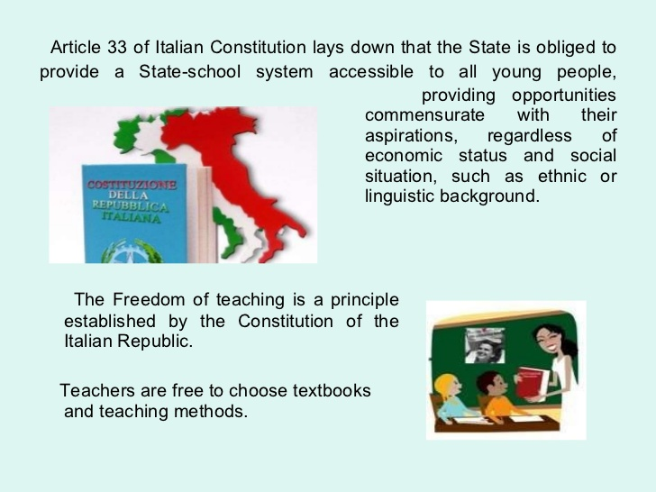
EDUCATIONAL SYSTEM
IN ITALY

Slide 2
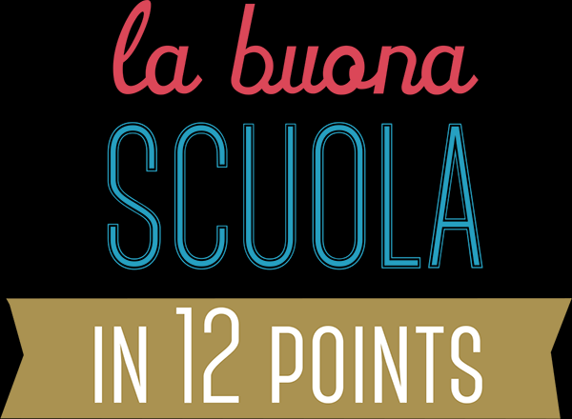
THE SCHOOL SYSTEM GETS UP-TO-DATE: TRAINING & INNOVATION
Professional development schemes, mandatory and based on peer collaboration. To foster a new generation of educators, in search of the Don Milani, Maria Montessori and Loris Malaguzzi of the 21st century.
FROM 2016, ONLY QUALIFIED TEACHERS
40 thousand qualified young new teachers will be hired between 2016 and 2019. From now on, teachers will be hired only via a public competition, as provided by the Italian Constitution.
CULTURA
IN CORPORE SANO
Betting on the very best of being Italian: more music and sports in primary schools and more Art history in secondary schools.
It is the school reform which is
officially in place from Sept 2015, signed by the Prime Minister,
Mr Matteo Renzi.
DIGITAL SCHOOLS
Matching fund schemes to reach each school with high-speed internet and Wi-Fi. Co-designing of refreshed digital services for the schools, to enhance transparency and reduce costs.
THE SCHOOL SYSTEM GETS TRANSPARENT: OPEN DATA & REGISTERS
From 2015, each school will publish its budget, a Self-Evaluation Report and all funded projects in details in open-data. A national register of teachers will support school principals to enhance their staff and the school teaching plan.
SCHOOL-AT-WORK.
Mandatory vocational training during the last 3 years of technical and professional curricula, for at least 200 hours per year. Extending pilots of didactic enterprise. Strenghtening experimental training experiences.
SCHOOL FOR ALL, ALL FOR SCHOOL
We will make the Budget for the Improvement of the didactical offer (MOF) stable and render its use transparent, linking the allocation of funds to the school Improvement Plan. We plan to attract private resources (from citizens, foundations, companies), through tax incentives and fast-track administrative procedures.

Slide 3

Administration and Governance at Central and/or Regional Level
In Italy teachers, or professors, are recruited by competitive examination.
- The Ministry of Education, University and Research (MIUR) is headquartered in Rome.
- The Regional School Office (Ufficio Scolastico Regionale, USR) is a branch of the Ministry of Education, University and Research (MIUR). Usually, it is divided into Local Offices that support and advise schools on administrative and accounting procedures and the planning and innovation of the educational offer. They monitor implementation of provisions on school buildings and safety and deal with the integration of immigrant and special needs pupils, the promotion of student participation in schools and, in collaboration with municipalities, they monitor compliance with compulsory schooling. They also carry out any activities that are delegated to them by the head of the Regional School Office.
Each school draws up its own Triennial Educational Plan.
The PTOF (Piano triennale dell’Offerta Formativa ) is the basic document setting out the cultural and planning identity of the school. It must be consistent with the general and educational objectives of the various kinds of study and specialisms set at national level and, at the same time, it must reflect cultural, social and economic requirements at local level.
The PTOF is drawn up by the Teachers’ Council (Collegio dei docenti) on the basis of general objectives defined by the District/School Council and taking into account the proposals and advice of parents organisations and associations and, at upper secondary level only, students associations. The PTOF must be approved by the District/School Council and given to students and their parents on enrolment.
Other Bodies and Agencies:
The Ministry of Education, University and Research (MIUR) has several bodies and agencies operating at national level: The National Education Council (Consiglio Nazionale della Pubblica Istruzione), an advisory body which assists the Minister with the planning and supervision of education policy, the National Institute for the Evaluation of the Education System (Istituto nazionale per la valutazione del sistema di istruzione, INVALSI) and the National Institute of Documentation, Innovation and Educational Research (Istituto Nazionale di Documentazione, Innovazione e Ricerca Educativa - INDIRE).

Slide 4
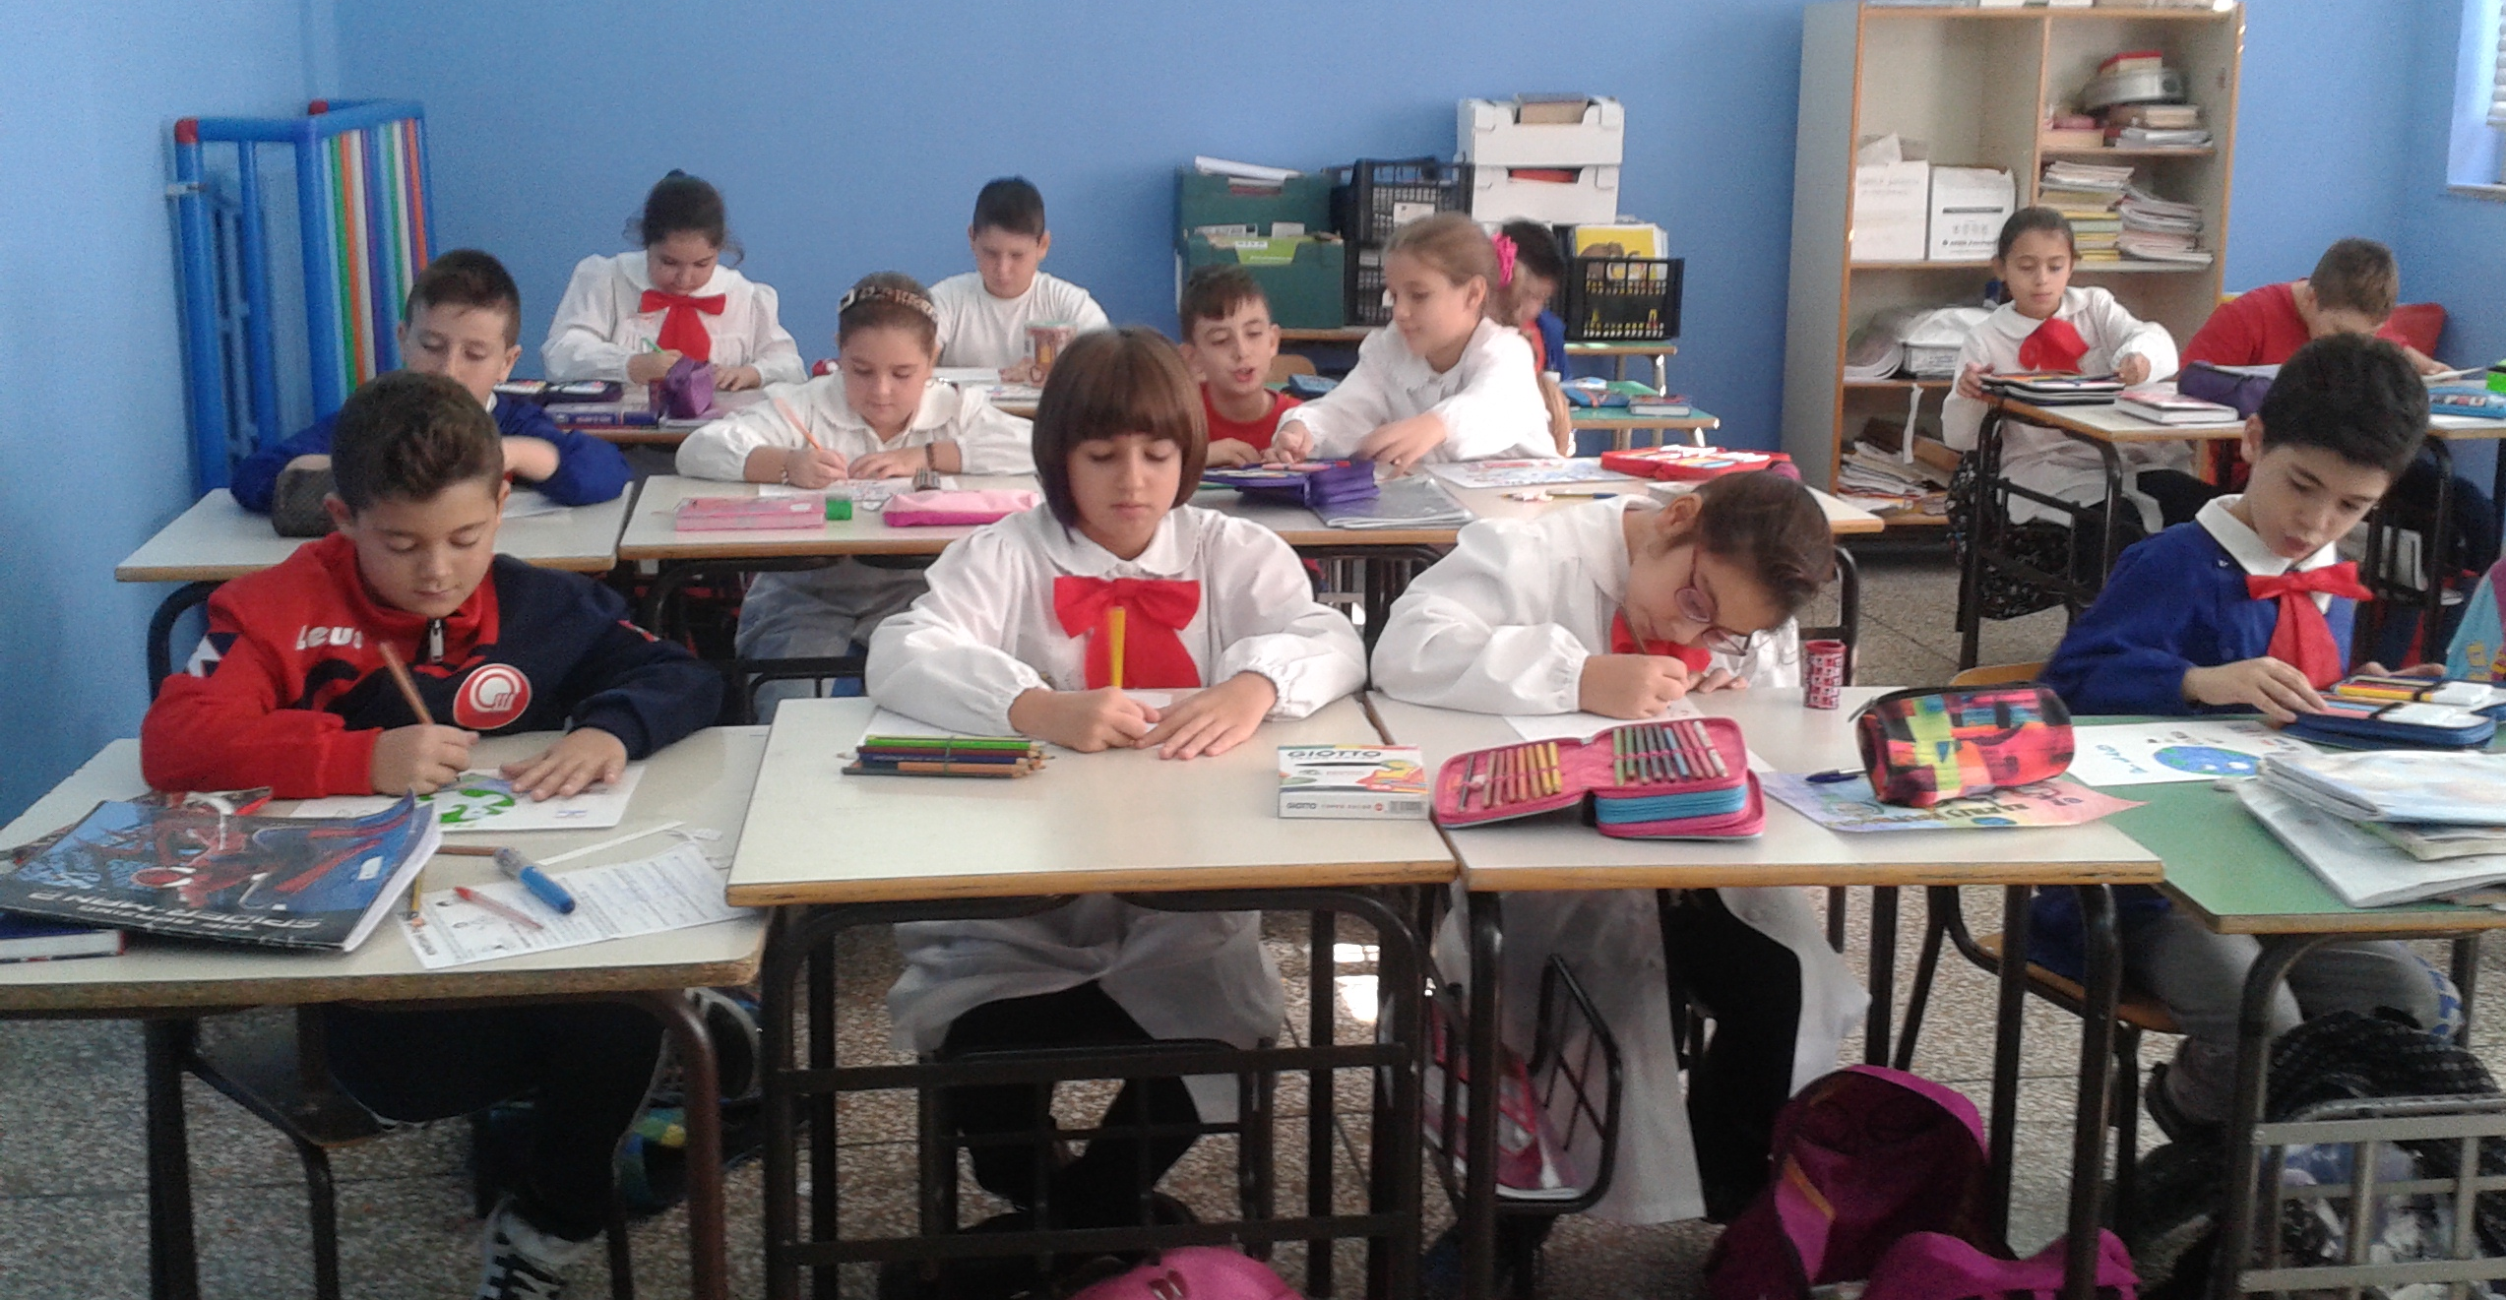
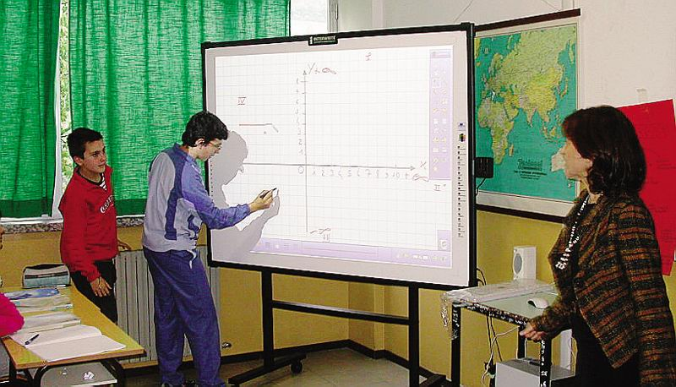
Education in Italy is compulsory from 6 to 16 years of age.
The education system in Italy is organised according to the subsidiary principle and autonomy of schools. The State has exclusive competence on general issues on education, on minimum standards to be guaranteed throughout the country and on the fundamental principles that Regions should comply with within their competences. Regions share their competences with the State on education issues while they have exclusive competence on vocational education and training. Schools are autonomous as for didactic, organisation and research and development activities. The education system is organised as follows:
Logo FLAG
Pre-school education:
First cycle of education: of 8 years, divided in two stages:
Pre-primary school (from 3 to 5) is not compulsory, which provides for a term of 3 years.
Primary school ( from 6– to 10) that provides for a term of 5 years;
lower secondary school (age 11 to 14 years), which lasts three years.

Slide 5


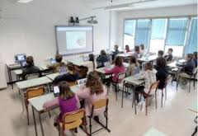
Second cycle of education: consisting of two paths:
Logo FLAG
Upper secondary school
which corresponds to the high-school level, of competence of the State (five years), addressed to pupils aged 14 to 19 years.
Belong to this path high schools, technical schools, professional instituties
Education and post-secondary non-tertiary education, which takes place within the system of Technical Education and Training (IFTS) and offering IFTS courses and Higher Technical Institutes (ITS).
Higher education consists of university and non-university education.
The cycle of studies at the university is divided into three levels:
1. Bachelor's degree – 3 years
2. Post graduate Master's Degree – 3+2 years
3. Master's degree - 5 or 6 years

Slide 6
Educational System Italy
REQUIRED TRAINING
(up to 18 years or qualification)
COMPULSORY EDUCATION
(up to 16 years)
3
5
3
3
4
5
3
3+2
5/6
Pre-primary school
Primary school
There is no specific certificate for the completion of primary education
Lower secondary school
Pupils who have passed the final examination receive the first-cycle leaving certificate (Diploma di licenza conclusiva del primo ciclo di istruzione), which must be signed by the chairman of the examination committee.
Upper secondary school
Students who pass the final State examination receive a Diploma Liceale and a certificate.
University
Students, who have completed a three-year programme are awarded a Laurea or a Accademic diploma.
Students, who have completed a second-cycle programme, are awarded a laurea magistrale or a Second level academic diploma.

Slide 7
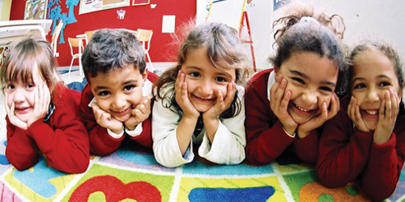
Assessment in Pre-primary Education
At pre-primary level, teachers do not assess children’s educational performance, rather they observe and interpret them. Teachers observe children occasionally and systematically in order to better understand their needs and to make balanced educational suggestions to be shared with the children’s parents. Indeed, the task of pre-primary schools is to promote, support and strengthen processes which allow children to develop their abilities in the best way possible.
Assessment of the levels attained includes the following:
• an initial period aimed at outlining the abilities possessed when entering pre-primary education;
• time within teaching activities aimed at adjusting and individualizing the educational and learning process;
• final period aimed at verifying learning outcomes, the quality of the educational and teaching activity and the entire educational experience. Record-taking enables both adults and children to keep a trace of performance, thus making the development process visible and progress in individual and group learning more valuable.
Text edited by the Italian Eurydice Unit – Content taken from Eurypedia (http://www.indire.it/eurydice/eurypedia/)

Slide 8

Assessment in Primary Education
The periodic and final evaluation of the pupils in a class is the responsibility of the teachers of that class. Evaluation focuses on the learning process of pupils, their behavior and their overall learning outcomes. These assessments should be consistent with the learning objectives set out in the three-year plan of training offer (PTOF) of each school. In the PTOF, the Teachers’ Council of each school also defines the methods and criteria for assuring that pupil assessment is uniform, transparent and fair.
Pupil Assessment Periodic assessment takes place at the end of each term. For assessment purposes, the school year is divided into three-month or four-month terms, as established by each school. Final assessment takes place at the end of each school year. Pupils do not take final examinations at the end of primary school.
The assessment of pupils with a certified disability follows the criteria described above (marks out of ten) and refers to their behavior, subjects and the activities included in each pupil’s individual educational plan. For pupils with certified specific learning difficulties (SpLD), assessment procedures must be adapted to the specific situation.
For pupils who are temporarily hospitalized and attend school while in hospital, assessment is guaranteed through the continuous exchange of information on the pupil’s work between hospital teachers and school teachers.
Teachers also certify the competences attained by pupils by the end of primary school.
Periodic and final evaluation of pupils’ learning outcomes in each subject is expressed in numerical marks out of ten
(from 0 to 10). Conduct is evaluated through a report assessment, which may be analytical or a summary, subject to the Teachers’ Council decision. At the end of each term and at the end of the school year, pupils receive a personal assessment document which includes their marks in numbers and letters for each subject, as well as a report of their behavior.
The external assessment of pupils’ learning outcomes is conducted by the INVALSI agency. For primary education, data is normally collected in the second and fifth years. The outcomes are returned to schools to provide school heads and teachers with useful tools for self-evaluation and to improve teaching.
Text edited by the Italian Eurydice Unit – Content taken from Eurypedia (http://www.indire.it/eurydice/eurypedia/)

Slide 9
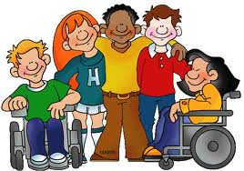
Development of inclusive education
Pupils with disabilities generally attend mainstream schools, in the ordinary sections and classes at all educational levels.
There are a few special institutes for pupils who are blind and deaf, which existed prior to Law 104/1992, as well as schools with specific tasks in the field of education for pupils with particularly severe disabilities.
Pupils and students with disabilities can enrol in upper-secondary education until the age of 18. They can complete compulsory education up until 18 years of age instead of 16.
During enrolment, parents must submit the specific certification issued by the relevant office after the mandatory disability identification procedures have been completed. Such documentation certifies the type of disability and the right to receive specific support.
Law 170/2010 recognises dyslexia, dysgraphia, dysorthographia and dyscalculia as specific learning disorders.
This Law – which states that pupils with learning disorders do not need special teachers, but rather a new way of teaching, according to their way of learning – promotes a change in perspective. The aim is to shift the focus from a clinical to a pedagogical view, by empowering all subjects involved in the educational process.
The Ministerial Directive of 27 December 2012, on ‘Measures for pupils with special educational needs and local organisations for school inclusion’, created a macro-category, an ‘umbrella’, to cover all kinds of difficulties – whether permanent or temporary – at school: disabilities, specific learning disorders, specific developmental disorders, socio-economic, cultural or linguistic disadvantages, as well as pupils that may be in need of special care. This ensures more inclusive practices in classrooms through individualised and personalised education plans.
Other special educational needs:
Socio-economic, cultural or linguistic disadvantages are identified at local and school level. In these cases, if needed, teachers can draw up personalised education plans.
Additional measures may include forms of support (e.g. exemption from some fees). In the case of foreign pupils, schools can set up language laboratories, either individually or in groups, to facilitate language learning.

Slide 10
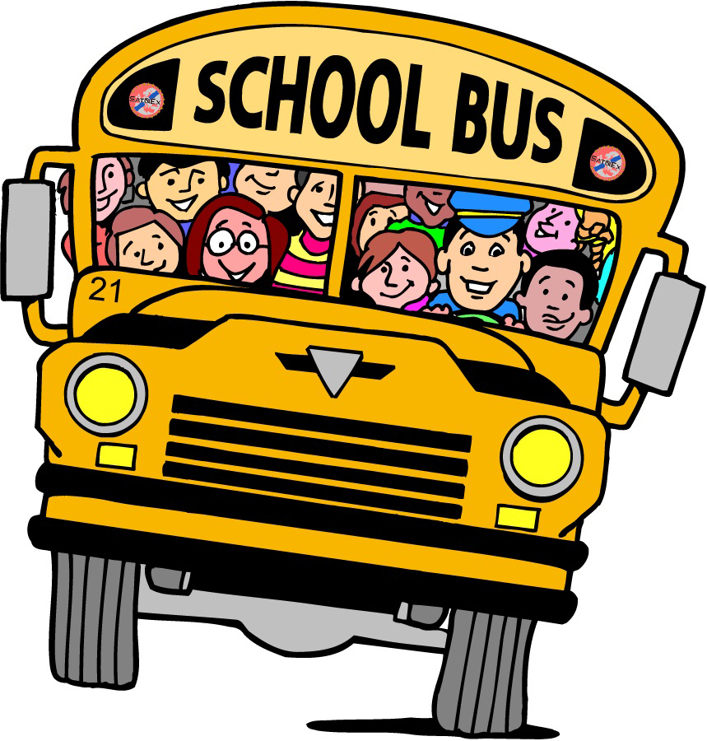


Organisation of the School Year
The Ministry of Education is responsible for setting the calendar for nationwide holidays, for all school levels. The Regions are responsible for defining the school calendar (start and end of school activities, length of breaks for national holidays, other holidays) so that it reflects 23 local needs. Every year, the Ministry publishes a summary table on its website showing all regional school calendars.
The school year starts on 1 September and ends on 31 August.
Teaching activities, including end-of-term assessments, final assessments and examinations, as well as in-service training activities are carried out between 1 September and 30 June.
The holiday calendar:
every Sunday; November 1, the Feast of All Saints; December 8, Immaculate Conception; December 25, Christmas; Dec. 26; January 1, New Year; January 6, Epiphany; the day on Monday after Easter; April 25, the anniversary of the Liberation; May 1, Labor Day; June 2, National Day of the Republic; the feast of the patron saint.
There are 200 teaching days in a year. For pupil evaluation purposes, the school year can be divided into 2 or 3 terms (periods of three or four months, as decided by the Teachers’ Council of each school).
The teaching timetable offers the following options:
• 24 hours a week;
• 27 hours a week;
• up to 30 hours a week, involving additional activities to the 27-hour timetable;
• 40 hours a week, including the lunchtime meal, known as ‘full-time’.
Parents can choose which timetable to enrol their children on.

Slide 11

Teaching and Learning in Primary Education
Curriculum, Subjects, Number of Hours
At primary level, the curriculum is defined through the National Guidelines for the Curriculum (Indicazioni nazionali per il curricolo) implemented from school year 2012/2013. As mentioned in the section on pre-primary school (scuola dell’infanzia), this document replaced the National Guidelines for the Personalised Study Plans in primary schools (Indicazioni nazionali per i piani di studio personalizzati) of 2004 and the Guidelines for the Curriculum (Indicazioni per il curricolo) of 2007. Specifically, the purpose of primary education is to enable pupils to acquire the fundamental knowledge and skills to develop basic cultural competence.
The reference for these new guidelines is the Framework for Key Competences for Lifelong Learning set up by the European Parliament and the Council of the European Union through the Recommendation of 18 December 2006.
The subjects taught during the 5 years of primary school are: Italian, English, history, geography, mathematics, science, technology, music, art, sports science (also called body, movement and sport), Catholic religious education. Catholic religious education is optional.
At primary level, there are no specific subject timetables. Only English and Catholic religious education have a specific timetable: one hour of teaching for English in the first grade, two hours in the second grade, three hours in the third, fourth and fifth grades, amounting to a minimum compulsory total of 396 hours throughout primary education. Two hours a week are allocated to either the teaching of Catholic religious education or alternative activities for those who opt not to take Catholic religious education.

Slide 12
48 C.D “Madre Claudia Russo”, NAPLES - Mainstream compulsory timetable (29 hours per week)
First classes | h Normal Time | h FULL TIME | Second classes | h Normal Time | h FULL TIME | Third and fourth classes | h Normal Time | h FULL TIME | Fifth classes | h Normal Time
Italian | 7 | 7+2 | Italian | 7 | 7+2 | Italian | 6 | 7+2 | Italian | 6
History | 2 | 2 | History | 2 | 2 | History | 2 | 2 | History | 2
Geography | 2 | 2 | Geography | 2 | 2 | Geography | 2 | 2 | Geography | 2
Art | 2 | 2 | Art | 1 | 2 | Art | 1 | 2 | Art | 1
Science | 2 | 2 | Science | 2 | 2 | Science | 2 | 2 | Science | 2
Mathematics | 6 | 6+2 | Mathematics | 6 | 6+2 | Mathematics | 6 | 6+2 | Mathematics | 6
Phisical Education | 1 | 3 | Phisical Education | 1 | 2 | Phisical Education | 1 | 2 | Phisical Education | 1
Music | 1 | 2 | Music | 1 | 2 | Music | 1 | 1 | Music | 1
English | 1 | 1 | English | 2 | 2 | English | 3 | 3 | English | 3
Technology | 1 | 2 | Technology | 1 | 2 | Technology | 1 | 1 | Technology | 1
I.R.C. | 2 | 2 | I.R.C. | 2 | 2 | I.R.C. | 2 | 2 | I.R.C. | 2
compulsory curriculum | 27+1 opt.+1 lunch | 35+5 opt. | compulsory curriculum | 27+1 opt.+1 lunch | 35+5 Opt. | compulsory curriculum | 27+1 opt.+1 lunch | 35+5 Opt. | compulsory curriculum | 27+1 opt.+1 lunch
quote
quote
quote
Optional activities are carried out in curricular time through the following laboratories: a) Laboratory expressive in Normal Time NOT FULL TIME
Language Laboratory-expressive
Mathematical laboratory
Expressive Workshop-musical for classes in FULL TIME

