Slide 1
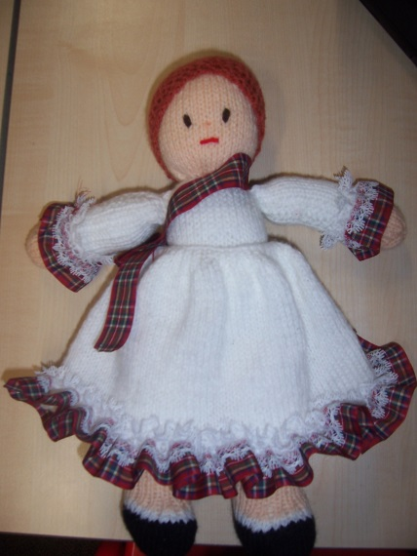
Morag and the Water Horse

Slide 2
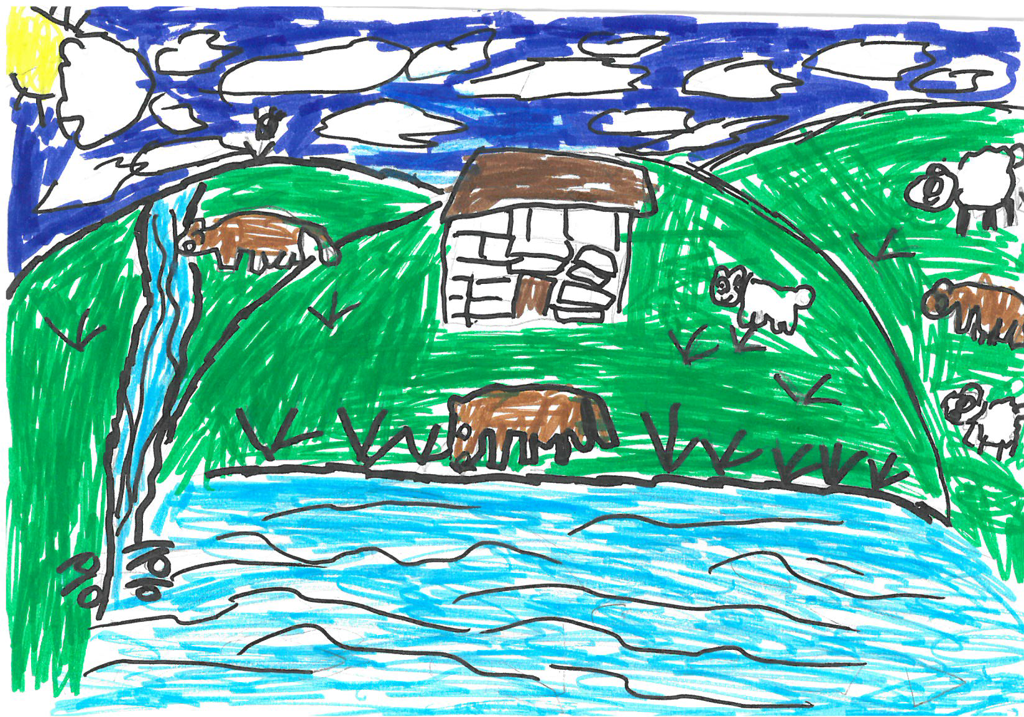
Once upon a time there was a village. In the village there was a girl called Morag and her beautiful dad that she loved so much, every thing was good. The birds are tweeting, the trees were shivering, everything was fine. They lived nearby the loch. The loch was known to be a very bad place where a water horse lived. He could turn into any form and came to take people down under the water where we are not supposed to be because we cant breathe. The water horse is a thing that can change into any thing to trick you.
(By Sara’a)

Slide 3
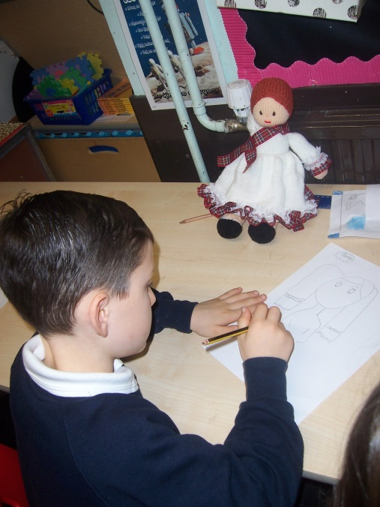

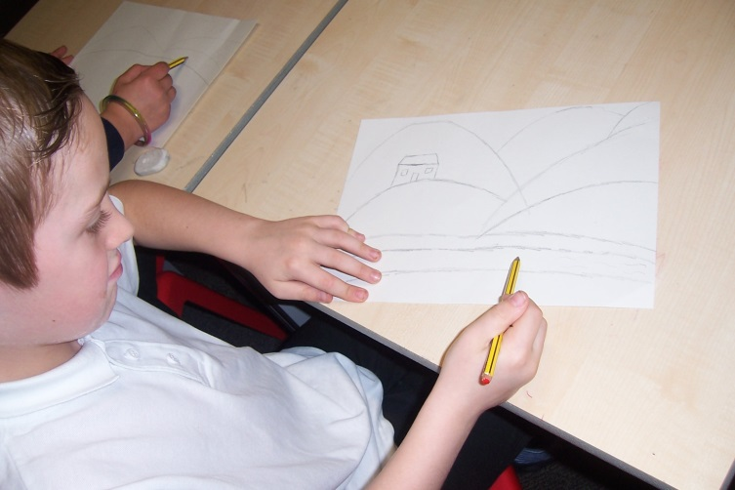
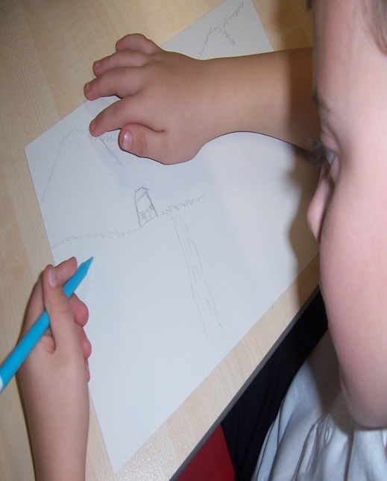
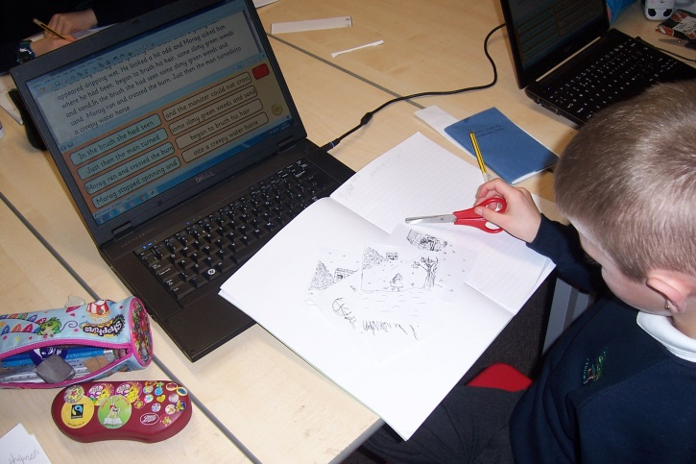
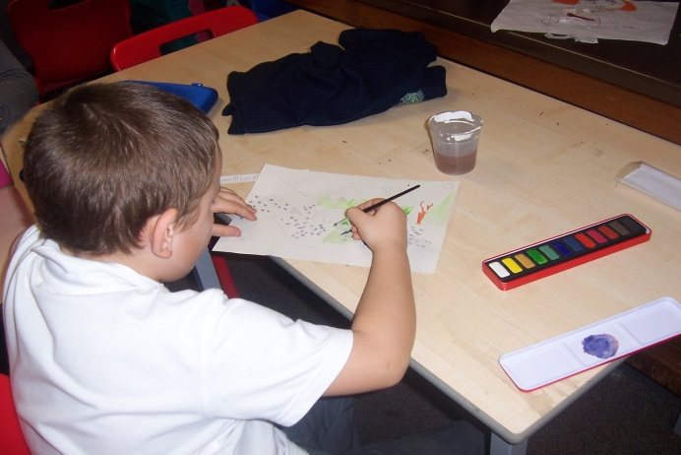
Photos of us at work!
We have been writing our own stories about Morag and the Water Horse. We have also drawn and painted the setting of the story.

Slide 4
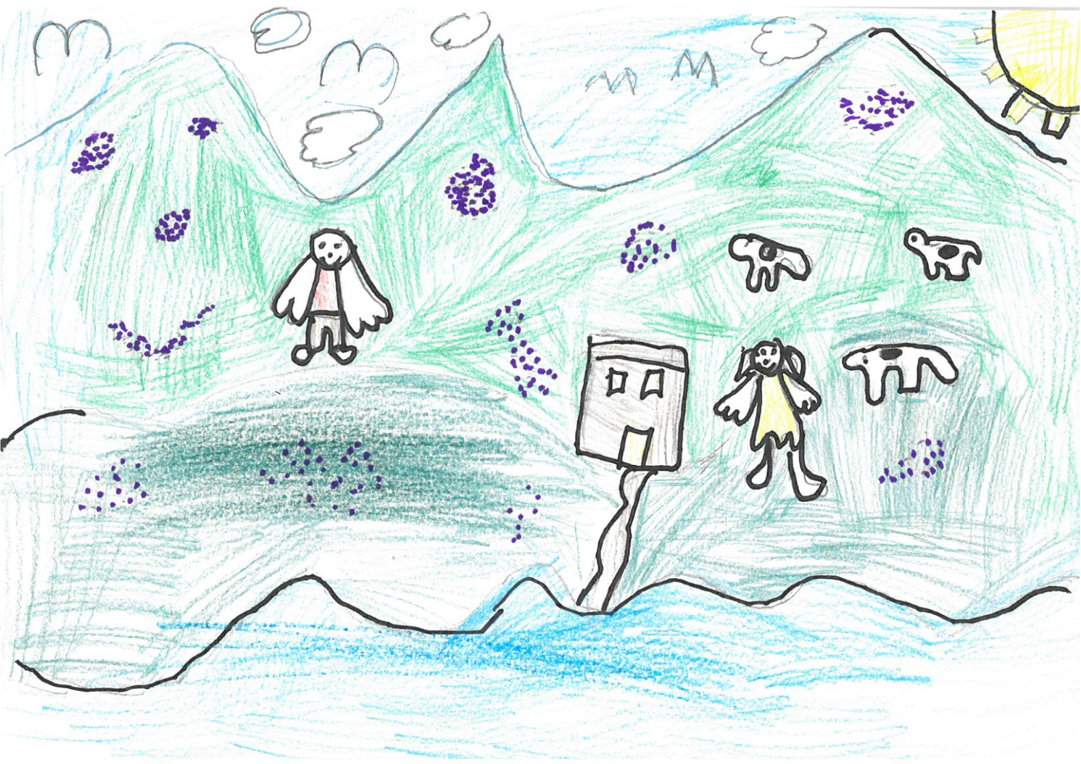
This shieling belonged to a man called Donald MacGregor and he had a daughter called Morag. She loved her father dearly. Morag was going to call the cattle in for the night. Her father had told her not to be afraid of the water horse that lived in the loch nearby although she had a trickle of fear crawling down her back.
Mr MacGregor’s neighbours warned them of the water horse and told them to move their home, but they didn’t believe it existed until one day…..and this is why.
(By Iona)

Slide 5
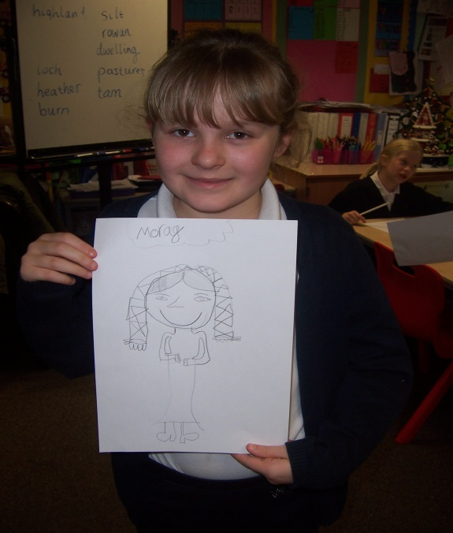
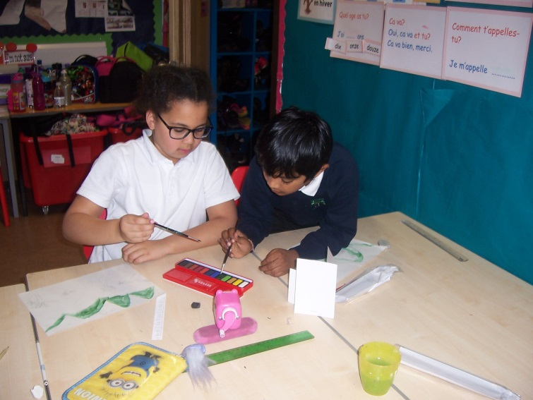
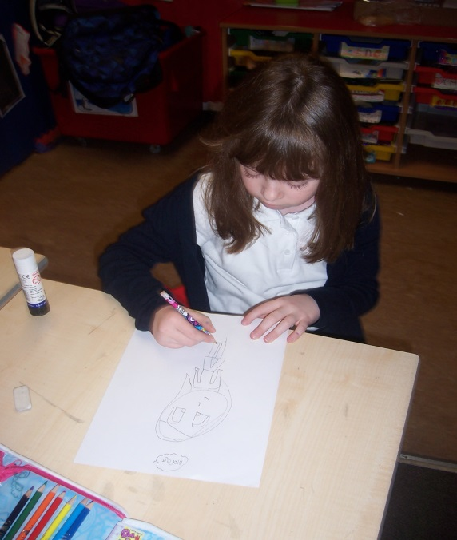
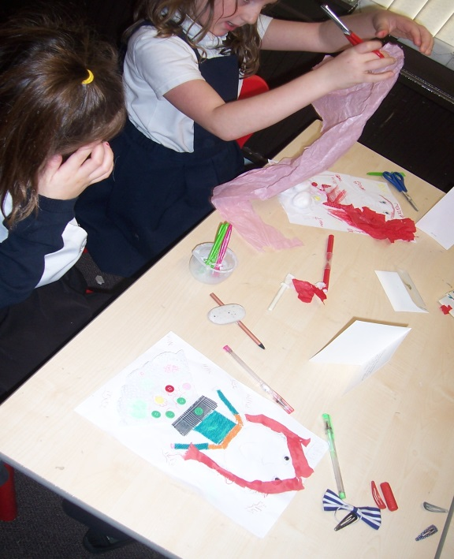
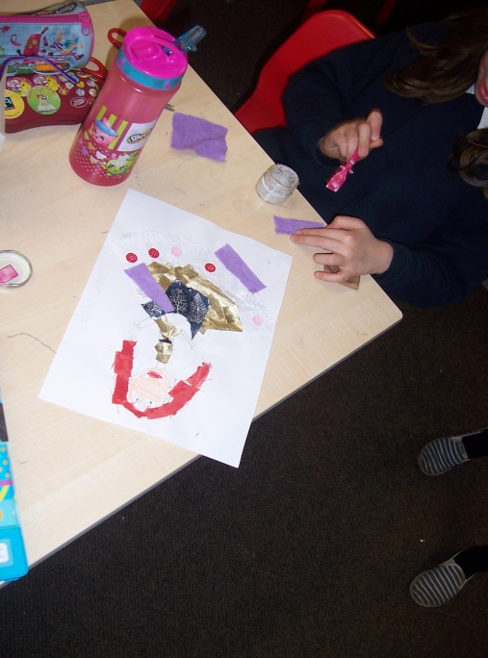
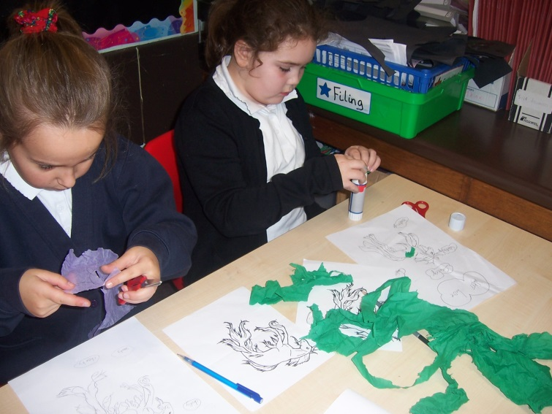
We have been using different materials to create our own characters.

Slide 6
One day Morag went out and got the black and white cattle. Morag loved to play in the beautiful heathers on the grass. Morag loved the cattle too. Morag shouted for the cattle (or cows) to come down from the hills. The cattle like to eat the grass. Morag was not that far away from the cottage she was just over at the big hills.
Morag went out to wind the spinning wheel - she loved to wind the spinning wheel. Until this boy came up all wet and also soggy. Morag asked him why he was all wet. And then he said oh well I slipped in the water on the way by accident . Oh dear said Morag. But Morag was scared because he appeared out of nowhere. She decided to believe him though.
(By Erin)

Slide 7
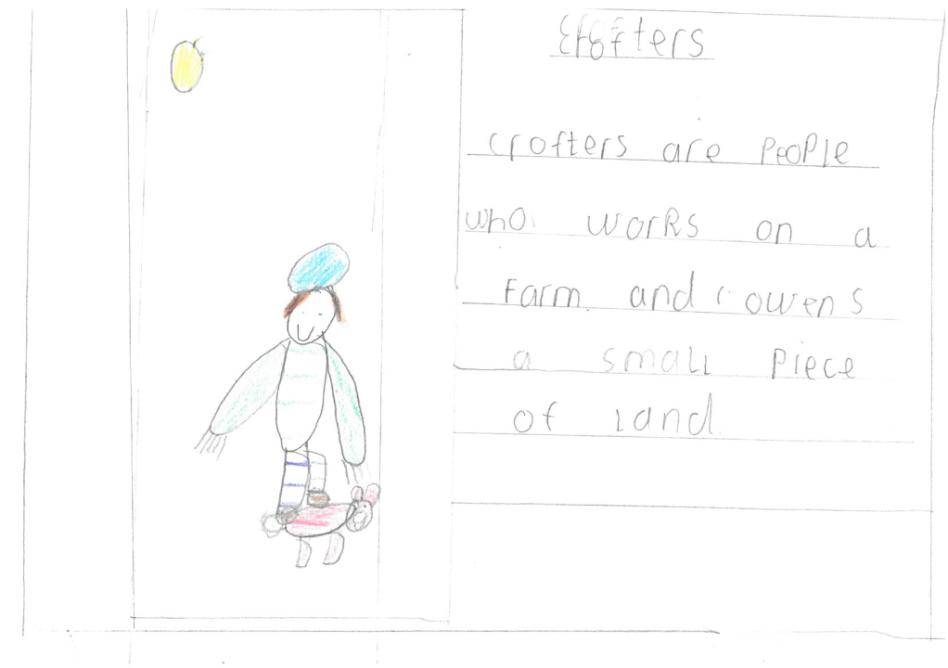
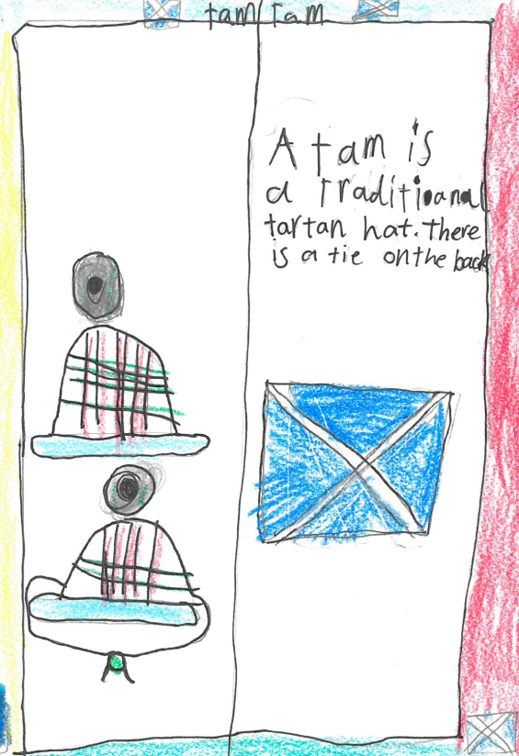
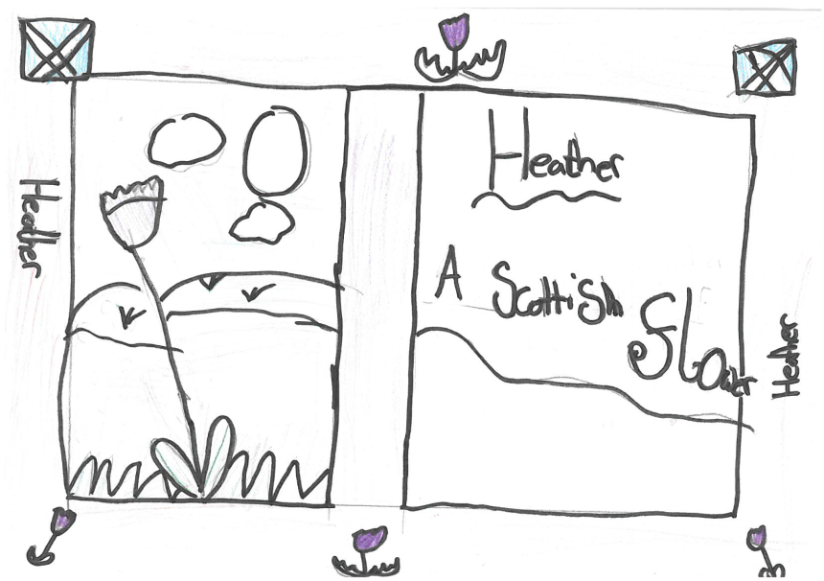
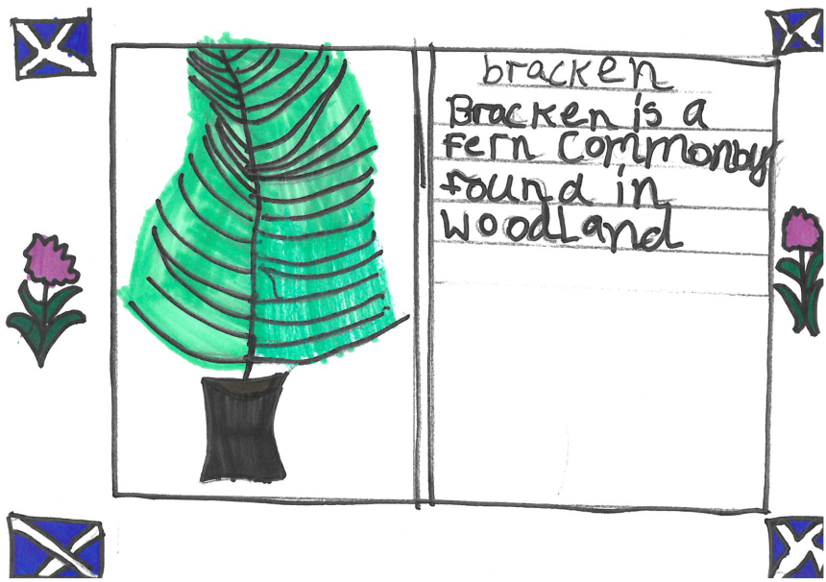
Dictionary Definitions

Slide 8
Morag said come and put your head on my lap so I can brush your messy hair and so he did.
Morag was brushing his hair and noticed that in it, was weeds and silt. Her father used to go fishing and the weeds and silt were on his white fishing net so she had recognised it as something you would find at the bottom of the loch…
(By Iona)

Slide 9
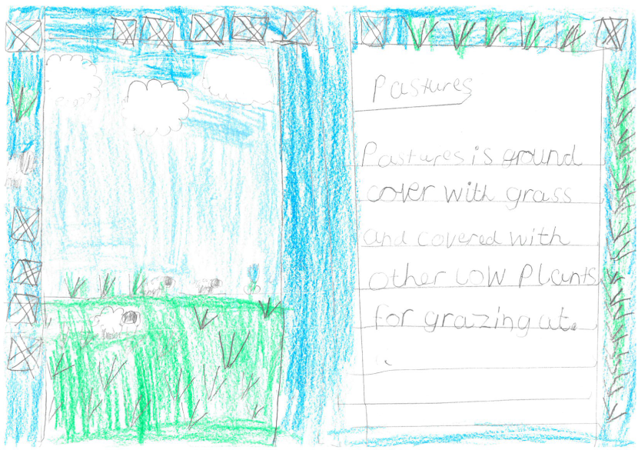
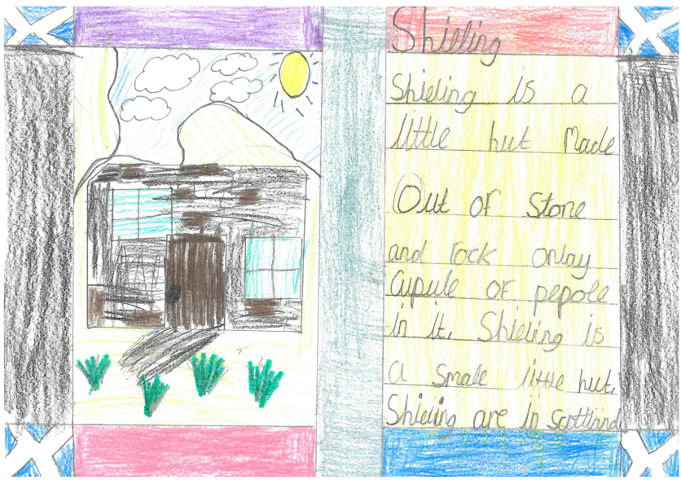
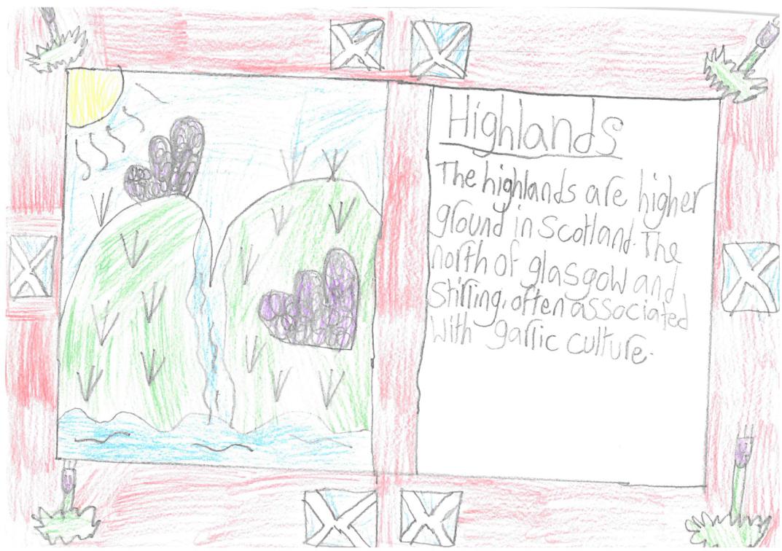
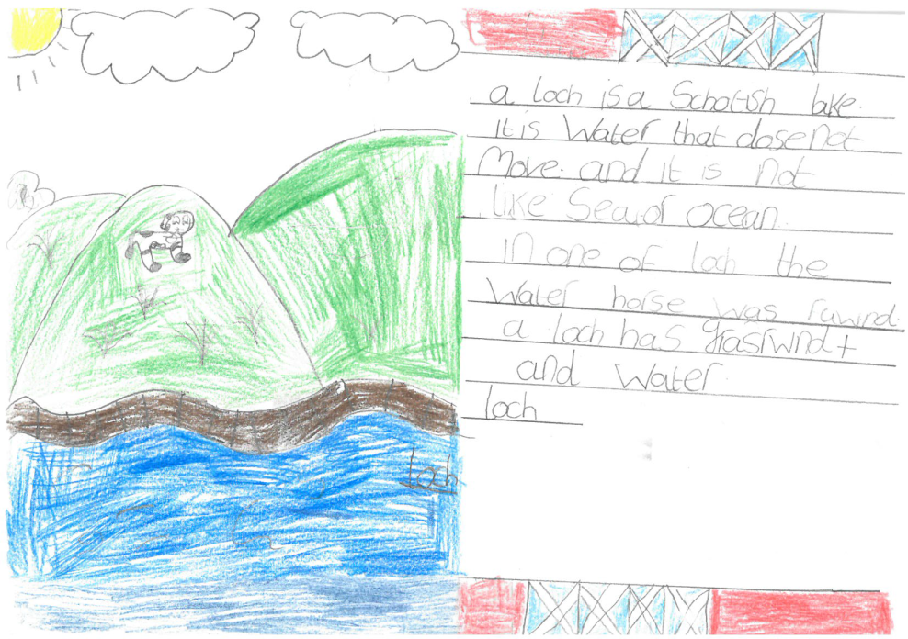

Slide 10
Morag then noticed that the young man was the water horse himself. Morag saw the scariness in the eyes and ran and screamed in horror. His shadow was darker than the darkest black. Morag was very scared.
(By Julia)
Morag ran towards the burn and jumped over smoothly she told her father all about it and he built another shieling at the other side of the burn.
(By Iona)

Slide 11
