Slide 1
JUROŠÍK

Slide 2
Jurošík left his home because he wanted to learn any craft to earn some money for living. He met Hrajnoha and became a highwayman near the castle of a stupid landowner.

Slide 3
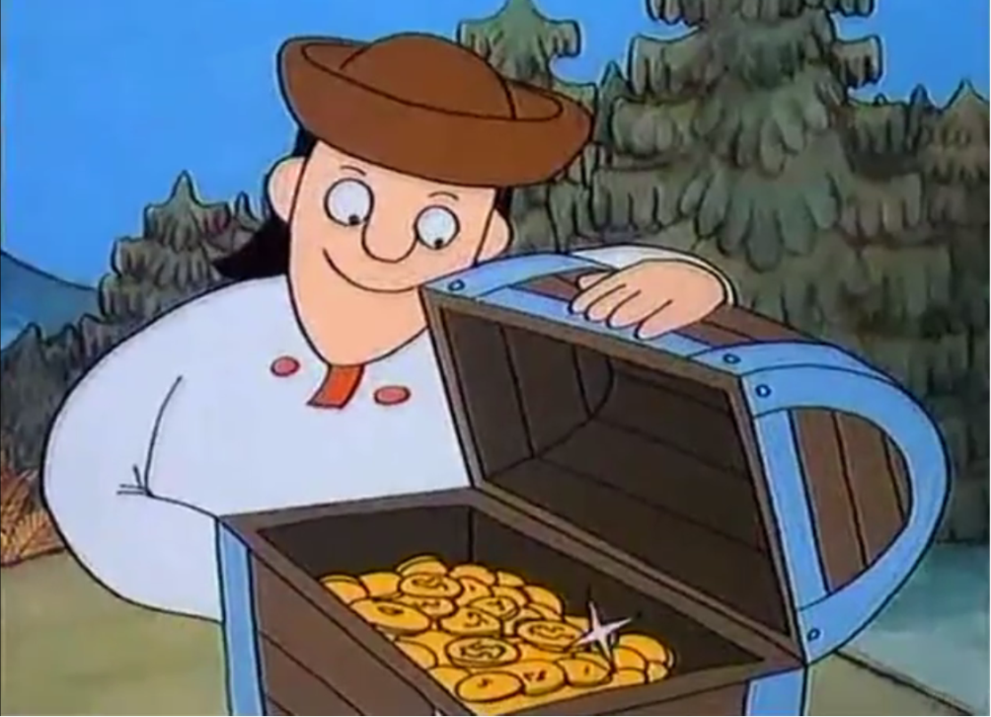
The landowner was rich. He behaved badly towards people and animals in his region. Jurošík robbed the landowner and helped poor people and animals.

Slide 4
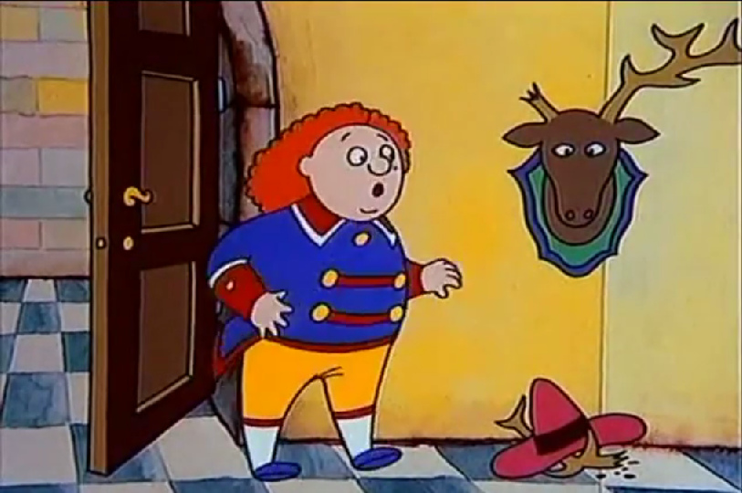
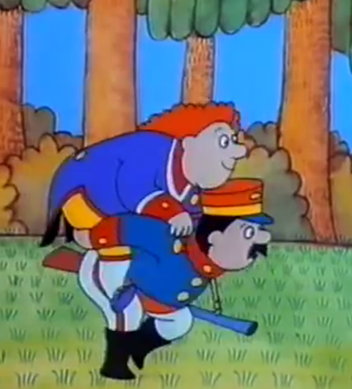
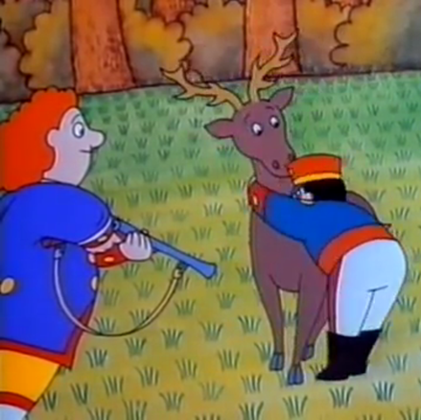
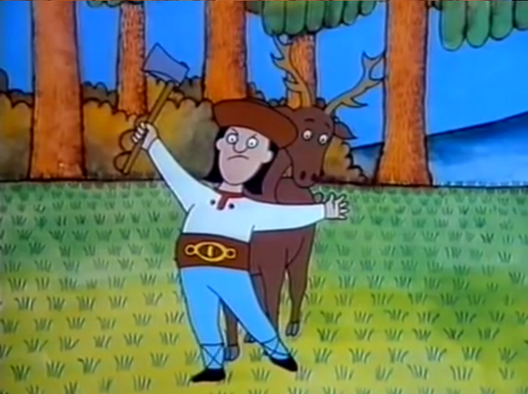
One day the landowner wanted to shoot deer, because he needed a new coat-rail from deer antlers. Jurošík stopped him shooting the animal and rescued the deer.

Slide 5
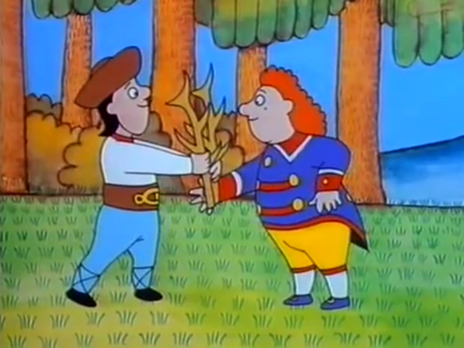
Jurošík knew that they did not need to shoot the deer. They could find the deer antlers in the forest. It was autumn and deer shed their antlers at that time. The landowner was satisfied and the deer stayed alive, thanks to Jurošík.

Slide 6
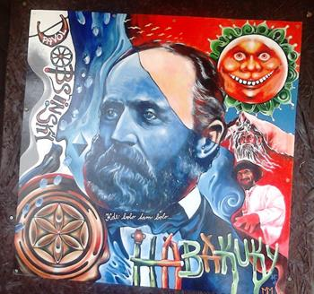
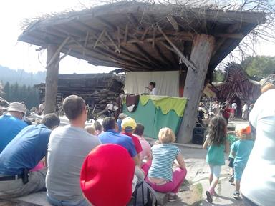
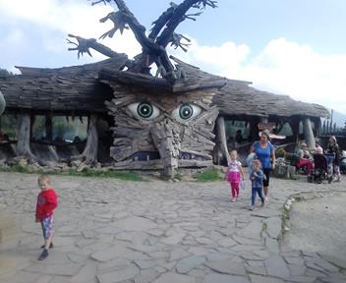
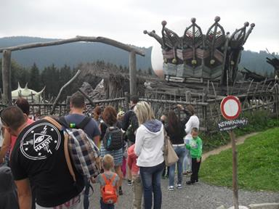
HABKUKY – fairytale town of Pavol Dobšinský
Children with their parents and teachers were looking for our traditional fairy tale hero among tradition Slovak fairy tales. Several of them we can watch in open-air theatre performances.

Slide 7
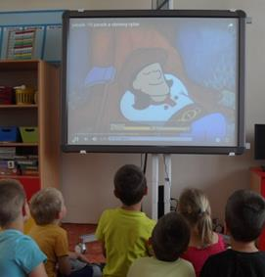
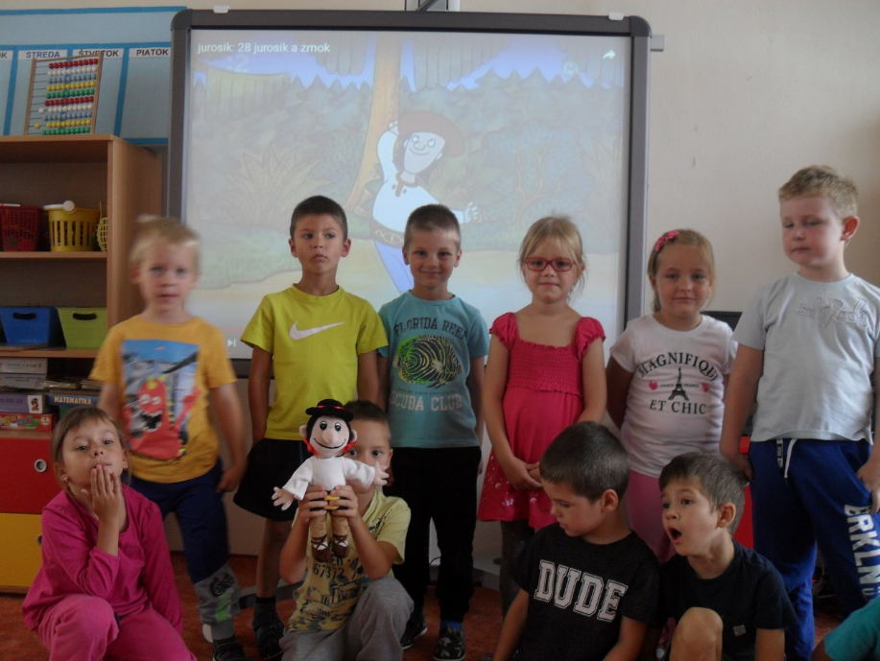
We chose a Slovak traditional hero
Juraj Jánošík – Jurošík.
Children watched animated stories about JUROŠÍK and then discussed the stories.

Slide 8
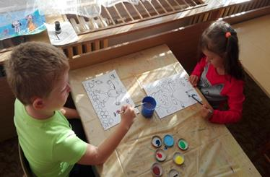
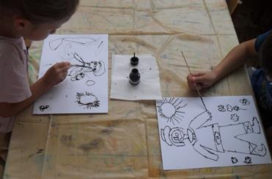
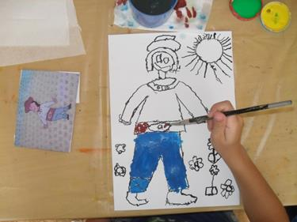
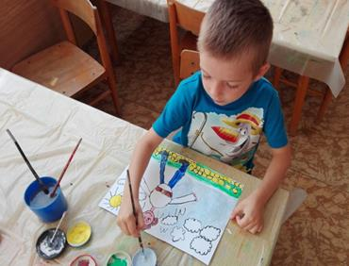
Drawing and painting

Slide 9
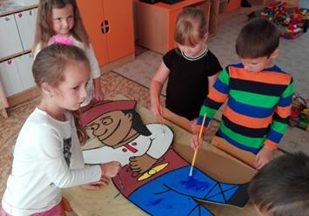
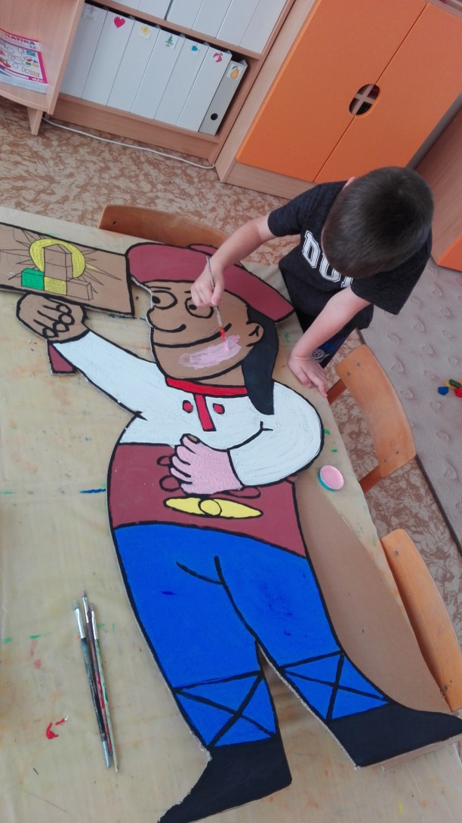
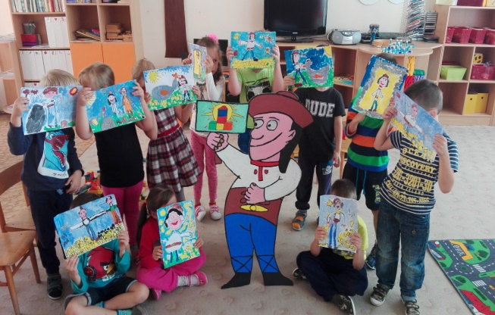
Making our mascot - Jurošík

Slide 10
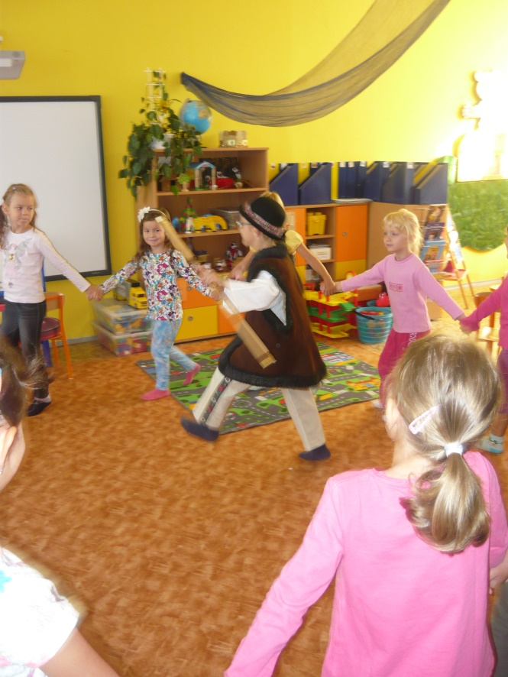
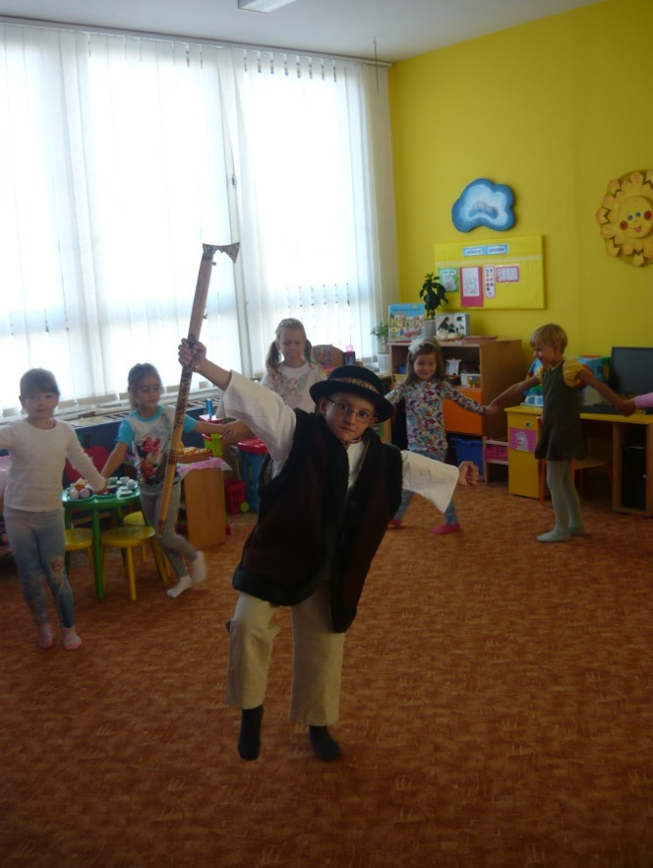
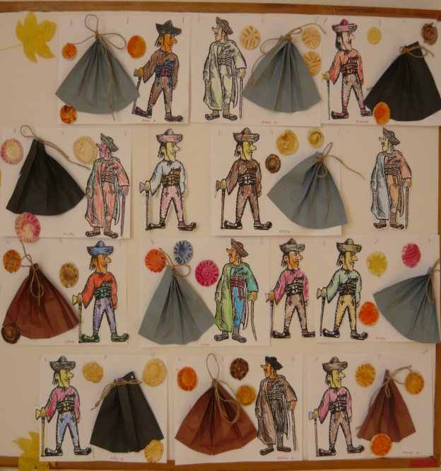
Highwayman
dance
All Slovaks know the story of the treasure which is hidden on an unknown place in the mountains. Juraj Jánošík has been the main character of many Slovak novels, poems and films.

Slide 11
The Legend of Juraj JánoŠík
Juraj Jánošík was a real person baptised on January 25, 1688, died March 17, 1713. He became the Slovak largest legend.
Juraj grew up in a family with many children and knew what misery was. He grew up on Terchova Kopanice and when he was twenty years old, he volunteered for the army of Frantisek Rakoczi. In a battle near Trencin, he was captured. Later, he served as a prison guard at Bytca Castle, where he met prisoner Uhorcík Thomas, a highwayman captain of Kysuce. After their escape from prison, Janosik became a member of Uhorcik´s bandit entourage. They were highwaymen who robbed the rich and gave a part of their plunder to the poor, or to those who were robbed by rich landlords. Juraj Janosik was elected to be the bandit captain for a year, but in 1713 he was caught in Liptov and arrested in Klenovec, together with Uhorcik. After a court hearing connected with the torture, Janosik was executed on 18th March 1713 in Liptovsky Mikulas, by hanging on a hook.

