Slide 1



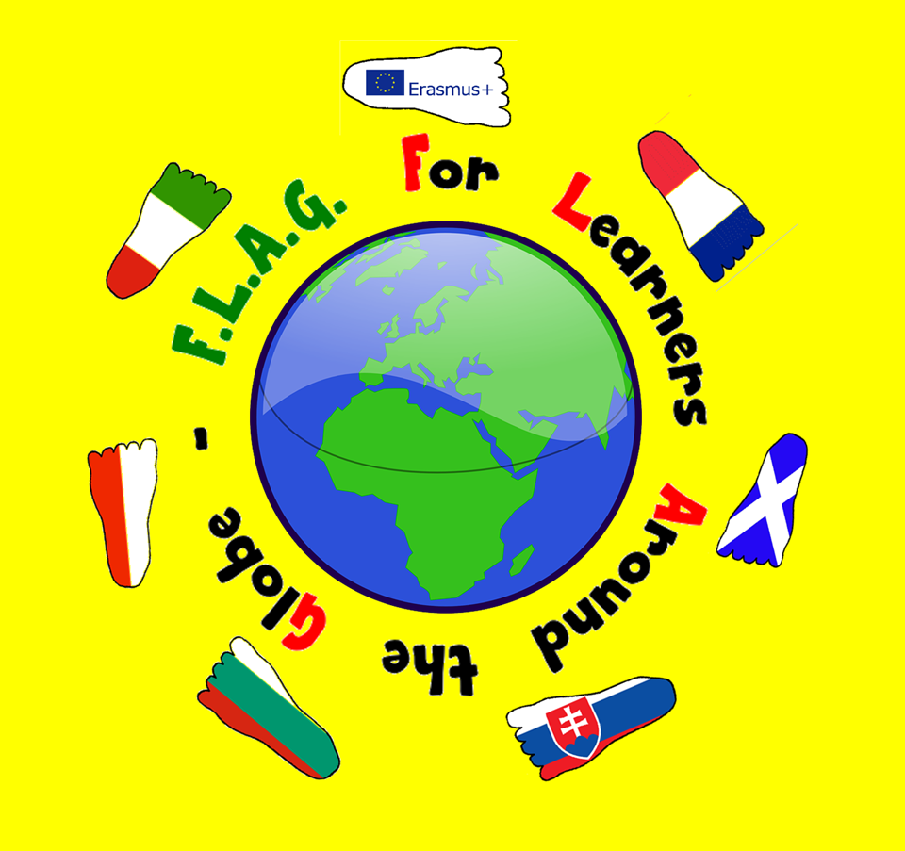
EDUCATIONAL SYSTEM IN BULGARIA

Slide 2
THE STRUCTURE OF EDUCATIONAL SYSTEM IN BULGARIA
NURSERY SCHOOL
KINDERGARTEN
PRIMARY EDUCATION
BASIC EDUCATION
SECONDARY EDUCATION
HIGHER EDUCATION

Slide 3
THE STRUCTURE OF EDUCATIONAL SYSTEM IN BULGARIA
IN BULGARIA CHILDREN AT THE AGE OF 2 TO 3 GO TO NURSERIES UNTIL THEY REACHED THE AGE REQUIRED FOR KINDERGARTEN.
When the children reach the age of 3 they can go to a kindergarten. There the children learn Bulgarian letters and how to count. They can also study the basic of a foreign language and prepared for the years in school.

Slide 4
SCHOOL EDUCATION
THE STRUCTURE OF EDUCATIONAL SYSTEM IN BULGARIA
Level
Primary
Age
7 – 11
15 – 19
Grade
1 - 4
5- 8
9 – 12
General
11 – 15
School
Primary school
Secondary school
Orientated schools
Pre-secondary
Education in Bulgaria is compulsory up to the age of 16.

Slide 5
THE STRUCTURE OF EDUCATIONAL SYSTEM IN BULGARIA
HIGHER EDUCATION
Students finish their Secondary Education at the age of 19. They have to pass matriculation exams before going to university.

Slide 6
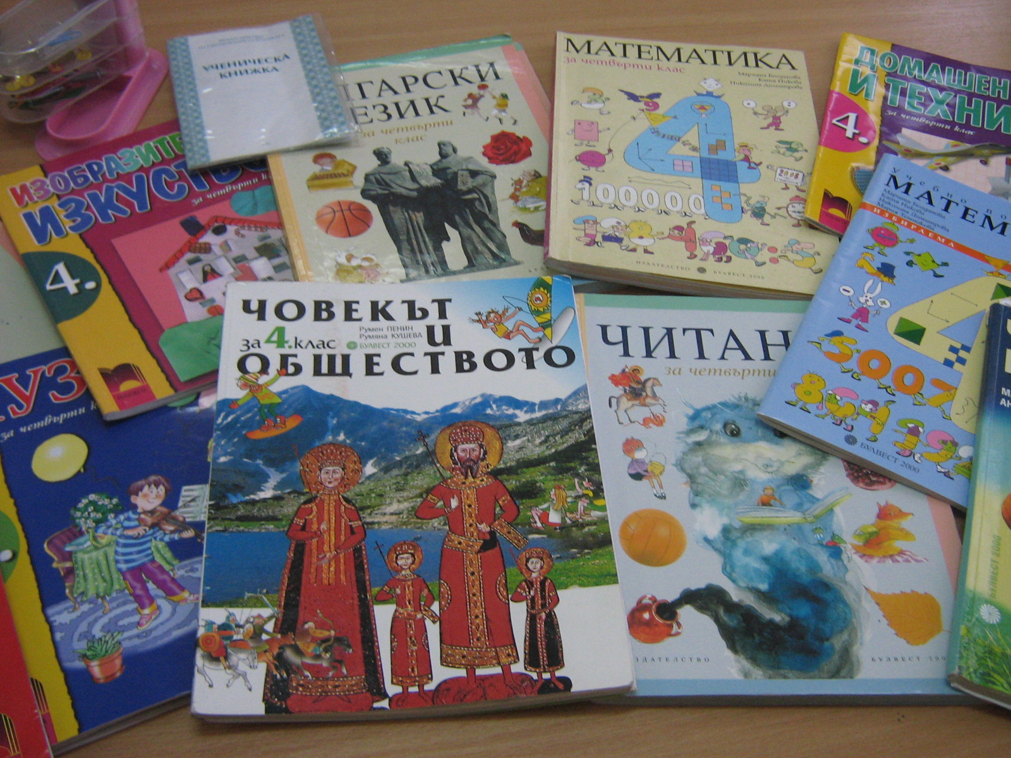
CURRICULUM
Our subjects
Bulgarian
English and second foreign language
Maths and IT
History and Geography
Nature Studies
Music
Art
Technology
P.E. – Physical Education and sport

Slide 7
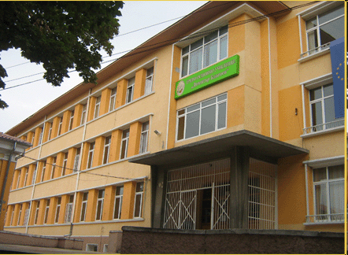
CURRICULUM
Our lessons
We go to school from Monday to Friday.
We go to school in the morning or in the afternoon.
We usually have got five/six lessons.
At the age of 14 the students sit an exam, and after they pass it they can choose among the high schools in their town.

Slide 8
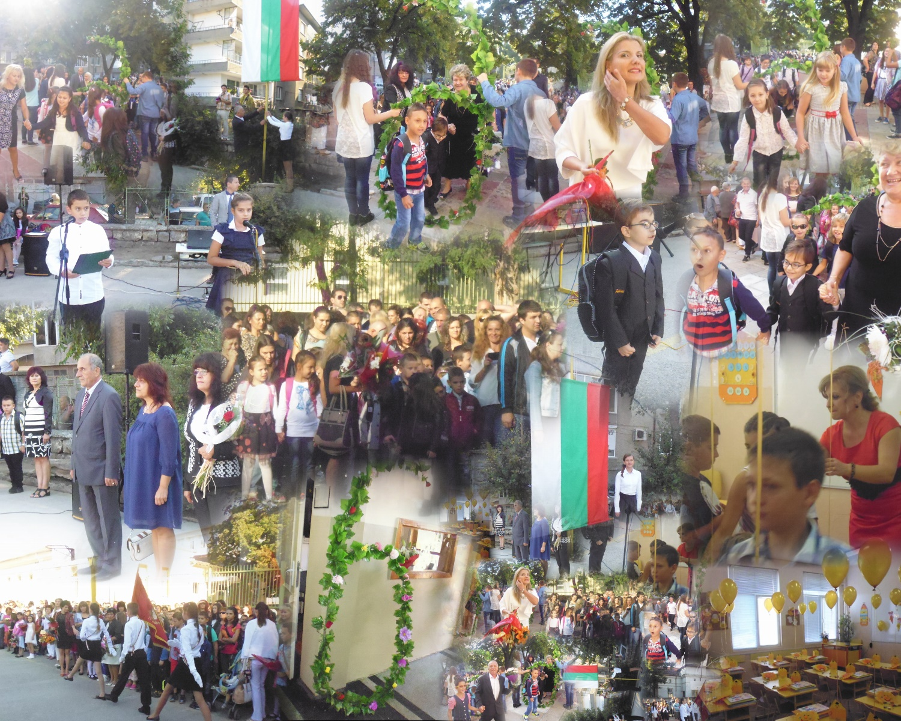
SCHOOL YEAR IN BULGARIA STARTS ON 15TH OF SEPTEMBER
SPECIFIC FEATURES
First grade students
start school at the
age of 7 and they learn until they pass their
basic education. At this time they can decide if they are going to learn
1 or 2 foreign
languages.

Slide 9

HOLIDAYS
SPECIFIC FEATURES
WINTER HOLIDAY
24th December – 4th January
MID – TERM
29th January – 2nd February
SPRING HOLIDAY
1st April – 10th April
SUMMER HOLIDAY
1st grade: 24th May – 15th September
2nd -4th grade – 31st May – 15th September
5th – 8th grade – 15th June – 15th September

Slide 10
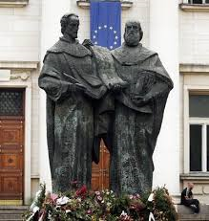
24th May Day of the Slavic Alphabet and Culture
SPECIFIC FEATURES
THE BULGARIAN ALPHABET
Alphabet and pronunciation of the letters with English examples
Notes:
Bulgarians honor the 24th of May as the Day of the Slavic Alphabet and Culture. All over the country schools are decorated with flowers and portraits of the brothers St.Cyril and St.Methodius. They are credited with devising the Glagolitic alphabet, the first alphabet used to transcribe the Old Church Slavonic language. The alphabet has official status with many organizations. With the accession of Bulgaria to the European Union on January 1, 2007 , Cyrillic became the third official alphabet of the EU. Up to 2007 there are more than 12 million people around the world who speak Bulgarian fluently.

Slide 11

EDUCATIONAL SYSTEM IN FRANCE

Slide 12
THE STRUCTURE OF EDUCATIONAL SYSTEM IN FRANCE.
French educational system
Our mission : to teach, to educate and to train.

Slide 13
THE STRUCTURE OF EDUCATIONAL SYSTEM IN FRANCE.
Logo FLAG
Department of Education
Rectorate of the Aix-Marseille’s academy
School inspectorate of Vaucluse
School inspectorate of the Avignon 1’s district
Public nursery school « Les Jardins – Vedène »

Slide 14
NEW CURRICULUM OF NURSERY SCHOOL (2015)
CURRICULUM
Logo FLAG
Five domains
To mobilize the language in all dimensions (oral and written)
To act, to express oneself, to understand through physical activities

Slide 15
NEW CURRICULUM OF NURSERY SCHOOL (2015)
CURRICULUM
Logo FLAG
To act, to express oneself, to understand through artistic activities
To construct the first tools to structure the thought
To explore the world (time, space, science)

Slide 16
SCHOOL YEAR IN FRANCE STARTS ON THE BEGINNING OF SEPTEMBER.
SPECIFIC FEATURES
Logo FLAG
School year starts on the beginning of september and finishes the first week of july. We are on holidays 2 weeks all around 7 weeks of school. We are with our pupils 24h per week : the morning and the afternoon of monday, thursday, tuesday and friday, and only the morning of the wednesday.

Slide 17
SPECIFIC FEATURES
HOLIDAYS
Logo FLAG
Holidays of All Saint’s Day : on the end of october to the begining of november
Holidays of Christmas : before Christmas’day to the begining of january
Holidays of the Winter : Around the end of february to the begining of march (3 different areas, 3 different dates)
Holidays of the Spring : Around the end of april to the begining of may (3 different areas, 3 different dates)
Holidays of the Summer : After the first week of july to the begining of september

Slide 18
DIFFERENT SCHOOLS
SPECIFIC FEATURES
Logo FLAG
Primary education
3 to 6 y.o., école maternelle – nursery school (3 levels)
6 to 11 y.o., école élémentaire – primary school (5 levels)
Secondary education
11 to 15 y.o., collège – lower secondary school (4 levels)
with the BEPC
15 to 18 y.o., lycée – upper secondary school (3 levels)
with the Baccalauréat

Slide 19
GENERAL PRINCIPLES
SPECIFIC FEATURES
Logo FLAG
Academic freedom
Free provision
Neutrality (on curriculum and teaching)
Secularism
Compulsory education (from 6 to 16 years-old)

Slide 20
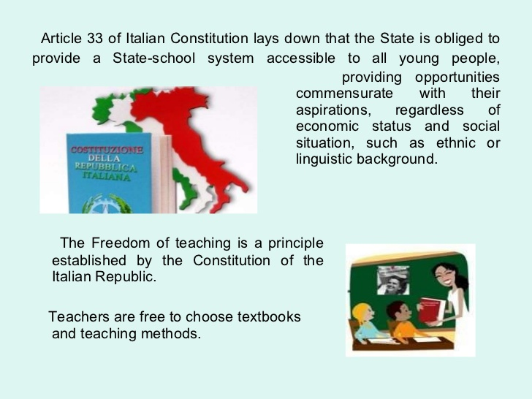
EDUCATIONAL SYSTEM IN ITALY

Slide 21
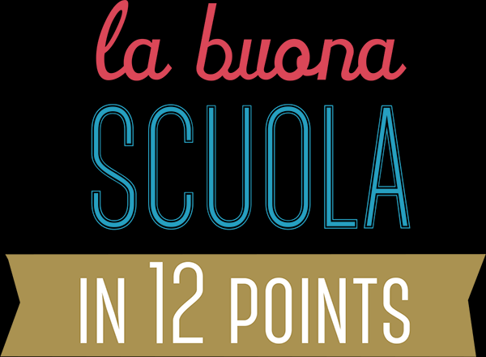
THE SCHOOL SYSTEM GETS UP-TO-DATE: TRAINING & INNOVATION
Professional development schemes, mandatory and based on peer collaboration. To foster a new generation of educators, in search of the Don Milani, Maria Montessori and Loris Malaguzzi of the 21st century.
FROM 2016, ONLY QUALIFIED TEACHERS
40 thousand qualified young new teachers will be hired between 2016 and 2019. From now on, teachers will be hired only via a public competition, as provided by the Italian Constitution.
CULTURA
IN CORPORE SANO
Betting on the very best of being Italian: more music and sports in primary schools and more Art history in secondary schools.
It is the school reform which is
officially in place from Sept 2015, signed by the Prime Minister,
Mr Matteo Renzi.
DIGITAL SCHOOLS
Matching fund schemes to reach each school with high-speed internet and Wi-Fi. Co-designing of refreshed digital services for the schools, to enhance transparency and reduce costs.
THE SCHOOL SYSTEM GETS TRANSPARENT: OPEN DATA & REGISTERS
From 2015, each school will publish its budget, a Self-Evaluation Report and all funded projects in details in open-data. A national register of teachers will support school principals to enhance their staff and the school teaching plan.
SCHOOL-AT-WORK.
Mandatory vocational training during the last 3 years of technical and professional curricula, for at least 200 hours per year. Extending pilots of didactic enterprise. Strenghtening experimental training experiences.
SCHOOL FOR ALL, ALL FOR SCHOOL
We will make the Budget for the Improvement of the didactical offer (MOF) stable and render its use transparent, linking the allocation of funds to the school Improvement Plan. We plan to attract private resources (from citizens, foundations, companies), through tax incentives and fast-track administrative procedures.

Slide 22

Administration and Governance at Central and/or Regional Level
In Italy teachers, or professors, are recruited by competitive examination.
- The Ministry of Education, University and Research (MIUR) is headquartered in Rome.
- The Regional School Office (Ufficio Scolastico Regionale, USR) is a branch of the Ministry of Education, University and Research (MIUR). Usually, it is divided into Local Offices that support and advise schools on administrative and accounting procedures and the planning and innovation of the educational offer. They monitor implementation of provisions on school buildings and safety and deal with the integration of immigrant and special needs pupils, the promotion of student participation in schools and, in collaboration with municipalities, they monitor compliance with compulsory schooling. They also carry out any activities that are delegated to them by the head of the Regional School Office.
Each school draws up its own Triennial Educational Plan.
The PTOF (Piano triennale dell’Offerta Formativa ) is the basic document setting out the cultural and planning identity of the school. It must be consistent with the general and educational objectives of the various kinds of study and specialisms set at national level and, at the same time, it must reflect cultural, social and economic requirements at local level.
The PTOF is drawn up by the Teachers’ Council (Collegio dei docenti) on the basis of general objectives defined by the District/School Council and taking into account the proposals and advice of parents organisations and associations and, at upper secondary level only, students associations. The PTOF must be approved by the District/School Council and given to students and their parents on enrolment.
Other Bodies and Agencies:
The Ministry of Education, University and Research (MIUR) has several bodies and agencies operating at national level: The National Education Council (Consiglio Nazionale della Pubblica Istruzione), an advisory body which assists the Minister with the planning and supervision of education policy, the National Institute for the Evaluation of the Education System (Istituto nazionale per la valutazione del sistema di istruzione, INVALSI) and the National Institute of Documentation, Innovation and Educational Research (Istituto Nazionale di Documentazione, Innovazione e Ricerca Educativa - INDIRE).

Slide 23
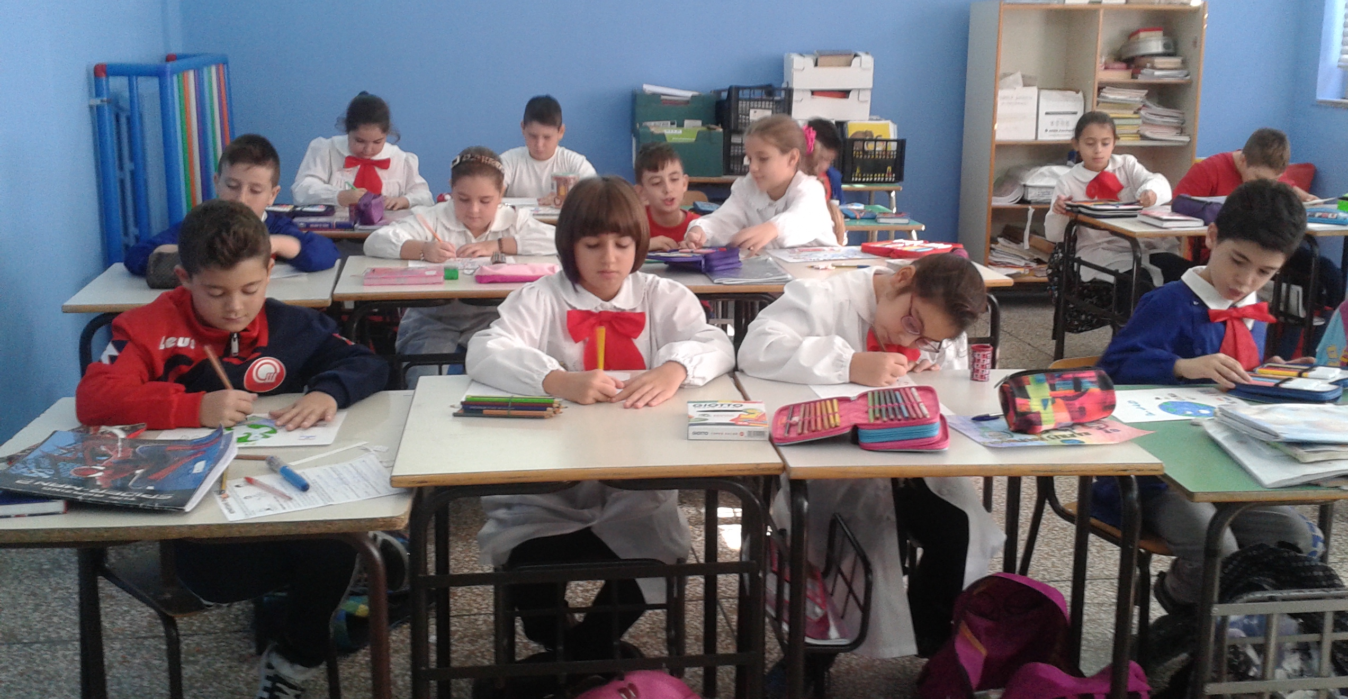
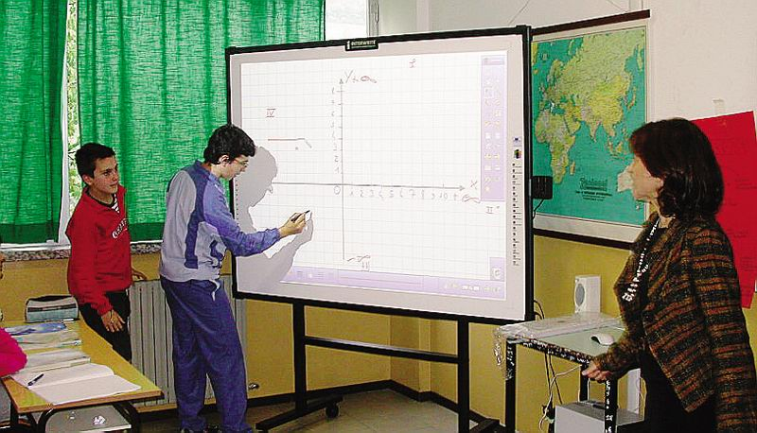
Education in Italy is compulsory from 6 to 16 years of age.
The education system in Italy is organised according to the subsidiary principle and autonomy of schools. The State has exclusive competence on general issues on education, on minimum standards to be guaranteed throughout the country and on the fundamental principles that Regions should comply with within their competences. Regions share their competences with the State on education issues while they have exclusive competence on vocational education and training. Schools are autonomous as for didactic, organisation and research and development activities. The education system is organised as follows:
Logo FLAG
Pre-school education:
First cycle of education: of 8 years, divided in two stages:
Pre-primary school (from 3 to 5) is not compulsory, which provides for a term of 3 years.
Primary school ( from 6– to 10) that provides for a term of 5 years;
lower secondary school (age 11 to 14 years), which lasts three years.

Slide 24


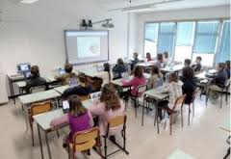
Second cycle of education: consisting of two paths:
Logo FLAG
Upper secondary school
which corresponds to the high-school level, of competence of the State (five years), addressed to pupils aged 14 to 19 years.
Belong to this path high schools, technical schools, professional instituties
Education and post-secondary non-tertiary education, which takes place within the system of Technical Education and Training (IFTS) and offering IFTS courses and Higher Technical Institutes (ITS).
Higher education consists of university and non-university education.
The cycle of studies at the university is divided into three levels:
1. Bachelor's degree – 3 years 2. Post graduate Master's Degree – 3+2 years 3. Master's degree - 5 or 6 years

Slide 25
Educational System Italy
REQUIRED TRAINING (up to 18 years or qualification)
COMPULSORY EDUCATION
(up to 16 years)
3
5
3
3
4
5
3
3+2
5/6
Pre-primary school
Primary school
There is no specific certificate for the completion of primary education
Lower secondary school
Pupils who have passed the final examination receive the first-cycle leaving certificate (Diploma di licenza conclusiva del primo ciclo di istruzione), which must be signed by the chairman of the examination committee.
Upper secondary school
Students who pass the final State examination receive a Diploma Liceale and a certificate.
University
Students, who have completed a three-year programme are awarded a Laurea or a Accademic diploma.
Students, who have completed a second-cycle programme, are awarded a laurea magistrale or a Second level academic diploma.

Slide 26
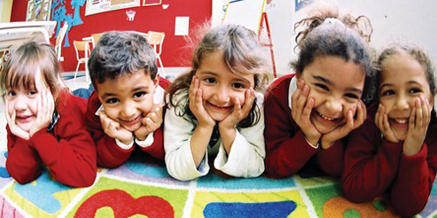
Assessment in Pre-primary Education
At pre-primary level, teachers do not assess children’s educational performance, rather they observe and interpret them. Teachers observe children occasionally and systematically in order to better understand their needs and to make balanced educational suggestions to be shared with the children’s parents. Indeed, the task of pre-primary schools is to promote, support and strengthen processes which allow children to develop their abilities in the best way possible.
Assessment of the levels attained includes the following:
• an initial period aimed at outlining the abilities possessed when entering pre-primary education;
• time within teaching activities aimed at adjusting and individualizing the educational and learning process;
• final period aimed at verifying learning outcomes, the quality of the educational and teaching activity and the entire educational experience. Record-taking enables both adults and children to keep a trace of performance, thus making the development process visible and progress in individual and group learning more valuable.
Text edited by the Italian Eurydice Unit – Content taken from Eurypedia (http://www.indire.it/eurydice/eurypedia/)

Slide 27
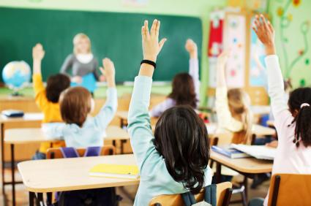
Assessment in Primary Education
The periodic and final evaluation of the pupils in a class is the responsibility of the teachers of that class. Evaluation focuses on the learning process of pupils, their behavior and their overall learning outcomes. These assessments should be consistent with the learning objectives set out in the three-year plan of training offer (PTOF) of each school. In the PTOF, the Teachers’ Council of each school also defines the methods and criteria for assuring that pupil assessment is uniform, transparent and fair.
Pupil Assessment Periodic assessment takes place at the end of each term. For assessment purposes, the school year is divided into three-month or four-month terms, as established by each school. Final assessment takes place at the end of each school year. Pupils do not take final examinations at the end of primary school.
The assessment of pupils with a certified disability follows the criteria described above (marks out of ten) and refers to their behavior, subjects and the activities included in each pupil’s individual educational plan. For pupils with certified specific learning difficulties (SpLD), assessment procedures must be adapted to the specific situation.
For pupils who are temporarily hospitalized and attend school while in hospital, assessment is guaranteed through the continuous exchange of information on the pupil’s work between hospital teachers and school teachers.
Teachers also certify the competences attained by pupils by the end of primary school.
Periodic and final evaluation of pupils’ learning outcomes in each subject is expressed in numerical marks out of ten
(from 0 to 10). Conduct is evaluated through a report assessment, which may be analytical or a summary, subject to the Teachers’ Council decision. At the end of each term and at the end of the school year, pupils receive a personal assessment document which includes their marks in numbers and letters for each subject, as well as a report of their behavior.
The external assessment of pupils’ learning outcomes is conducted by the INVALSI agency. For primary education, data is normally collected in the second and fifth years. The outcomes are returned to schools to provide school heads and teachers with useful tools for self-evaluation and to improve teaching.
Text edited by the Italian Eurydice Unit – Content taken from Eurypedia (http://www.indire.it/eurydice/eurypedia/)

Slide 28
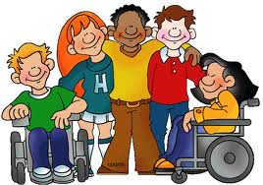
Development of inclusive education
Pupils with disabilities generally attend mainstream schools, in the ordinary sections and classes at all educational levels.
There are a few special institutes for pupils who are blind and deaf, which existed prior to Law 104/1992, as well as schools with specific tasks in the field of education for pupils with particularly severe disabilities.
Pupils and students with disabilities can enrol in upper-secondary education until the age of 18. They can complete compulsory education up until 18 years of age instead of 16.
During enrolment, parents must submit the specific certification issued by the relevant office after the mandatory disability identification procedures have been completed. Such documentation certifies the type of disability and the right to receive specific support.
Law 170/2010 recognises dyslexia, dysgraphia, dysorthographia and dyscalculia as specific learning disorders.
This Law – which states that pupils with learning disorders do not need special teachers, but rather a new way of teaching, according to their way of learning – promotes a change in perspective. The aim is to shift the focus from a clinical to a pedagogical view, by empowering all subjects involved in the educational process.
The Ministerial Directive of 27 December 2012, on ‘Measures for pupils with special educational needs and local organisations for school inclusion’, created a macro-category, an ‘umbrella’, to cover all kinds of difficulties – whether permanent or temporary – at school: disabilities, specific learning disorders, specific developmental disorders, socio-economic, cultural or linguistic disadvantages, as well as pupils that may be in need of special care. This ensures more inclusive practices in classrooms through individualised and personalised education plans.
Other special educational needs:
Socio-economic, cultural or linguistic disadvantages are identified at local and school level. In these cases, if needed, teachers can draw up personalised education plans.
Additional measures may include forms of support (e.g. exemption from some fees). In the case of foreign pupils, schools can set up language laboratories, either individually or in groups, to facilitate language learning.

Slide 29
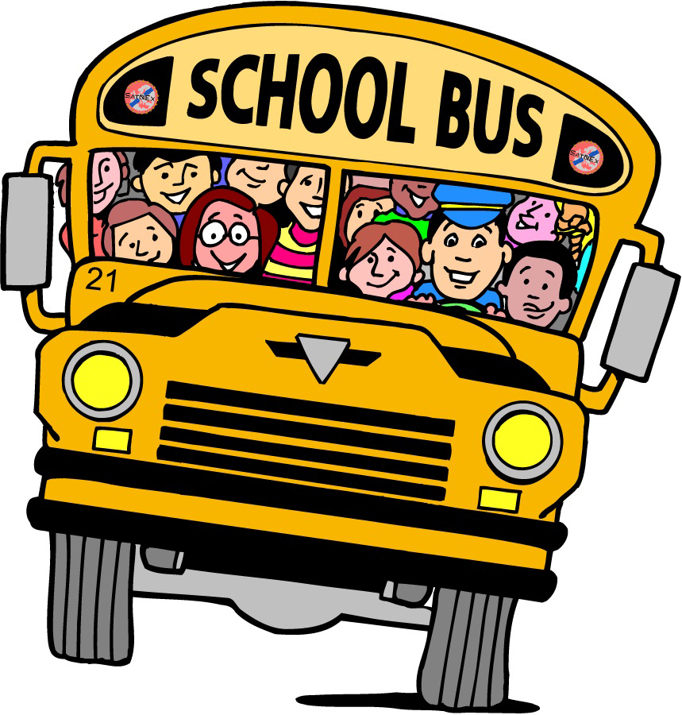
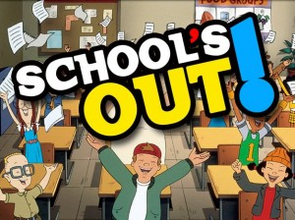

Organisation of the School Year
The Ministry of Education is responsible for setting the calendar for nationwide holidays, for all school levels. The Regions are responsible for defining the school calendar (start and end of school activities, length of breaks for national holidays, other holidays) so that it reflects 23 local needs. Every year, the Ministry publishes a summary table on its website showing all regional school calendars.
The school year starts on 1 September and ends on 31 August.
Teaching activities, including end-of-term assessments, final assessments and examinations, as well as in-service training activities are carried out between 1 September and 30 June.
The holiday calendar:
every Sunday; November 1, the Feast of All Saints; December 8, Immaculate Conception; December 25, Christmas; Dec. 26; January 1, New Year; January 6, Epiphany; the day on Monday after Easter; April 25, the anniversary of the Liberation; May 1, Labor Day; June 2, National Day of the Republic; the feast of the patron saint.
There are 200 teaching days in a year. For pupil evaluation purposes, the school year can be divided into 2 or 3 terms (periods of three or four months, as decided by the Teachers’ Council of each school).
The teaching timetable offers the following options:
• 24 hours a week;
• 27 hours a week;
• up to 30 hours a week, involving additional activities to the 27-hour timetable;
• 40 hours a week, including the lunchtime meal, known as ‘full-time’.
Parents can choose which timetable to enrol their children on.

Slide 30
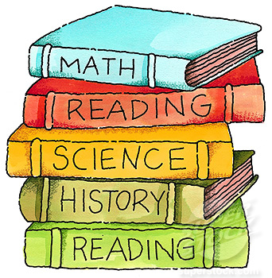
Teaching and Learning in Primary Education
Curriculum, Subjects, Number of Hours
At primary level, the curriculum is defined through the National Guidelines for the Curriculum (Indicazioni nazionali per il curricolo) implemented from school year 2012/2013. As mentioned in the section on pre-primary school (scuola dell’infanzia), this document replaced the National Guidelines for the Personalised Study Plans in primary schools (Indicazioni nazionali per i piani di studio personalizzati) of 2004 and the Guidelines for the Curriculum (Indicazioni per il curricolo) of 2007. Specifically, the purpose of primary education is to enable pupils to acquire the fundamental knowledge and skills to develop basic cultural competence.
The reference for these new guidelines is the Framework for Key Competences for Lifelong Learning set up by the European Parliament and the Council of the European Union through the Recommendation of 18 December 2006.
The subjects taught during the 5 years of primary school are: Italian, English, history, geography, mathematics, science, technology, music, art, sports science (also called body, movement and sport), Catholic religious education. Catholic religious education is optional.
At primary level, there are no specific subject timetables. Only English and Catholic religious education have a specific timetable: one hour of teaching for English in the first grade, two hours in the second grade, three hours in the third, fourth and fifth grades, amounting to a minimum compulsory total of 396 hours throughout primary education. Two hours a week are allocated to either the teaching of Catholic religious education or alternative activities for those who opt not to take Catholic religious education.

Slide 31
48 C.D “Madre Claudia Russo”, NAPLES - Mainstream compulsory timetable (29 hours per week)
First classes | h Normal Time | h FULL TIME | Second classes | h Normal Time | h FULL TIME | Third and fourth classes | h Normal Time | h FULL TIME | Fifth classes | h Normal Time
Italian | 7 | 7+2 | Italian | 7 | 7+2 | Italian | 6 | 7+2 | Italian | 6
History | 2 | 2 | History | 2 | 2 | History | 2 | 2 | History | 2
Geography | 2 | 2 | Geography | 2 | 2 | Geography | 2 | 2 | Geography | 2
Art | 2 | 2 | Art | 1 | 2 | Art | 1 | 2 | Art | 1
Science | 2 | 2 | Science | 2 | 2 | Science | 2 | 2 | Science | 2
Mathematics | 6 | 6+2 | Mathematics | 6 | 6+2 | Mathematics | 6 | 6+2 | Mathematics | 6
Phisical Education | 1 | 3 | Phisical Education | 1 | 2 | Phisical Education | 1 | 2 | Phisical Education | 1
Music | 1 | 2 | Music | 1 | 2 | Music | 1 | 1 | Music | 1
English | 1 | 1 | English | 2 | 2 | English | 3 | 3 | English | 3
Technology | 1 | 2 | Technology | 1 | 2 | Technology | 1 | 1 | Technology | 1
I.R.C. | 2 | 2 | I.R.C. | 2 | 2 | I.R.C. | 2 | 2 | I.R.C. | 2
compulsory curriculum | 27+1 opt.+1 lunch | 35+5 opt. | compulsory curriculum | 27+1 opt.+1 lunch | 35+5 Opt. | compulsory curriculum | 27+1 opt.+1 lunch | 35+5 Opt. | compulsory curriculum | 27+1 opt.+1 lunch
quote
quote
quote
Optional activities are carried out in curricular time through the following laboratories: a) Laboratory expressive in Normal Time NOT FULL TIME
Language Laboratory-expressive
Mathematical laboratory
Expressive Workshop-musical for classes in FULL TIME

Slide 32


EDUCATIONAL SYSTEM IN POLAND
FLAG – For Learners Around the Globe / Erasmus+ project 2015-2017

Slide 33
THE POLISH EDUCATION SYSTEM
Education in Poland is free of charge. The present school system in Poland was introduced in 1998/1999. Many changes concerning administration, financing, inspection, supervision and guidance have been implemented since then.
Full-time education is compulsory from 5 till 18. The academic year begins on 1st September and ends on the last Friday of June, and is divided into two terms. Students have 2-month and a week of holidays in summer, two weeks of half-year holiday in winter (January/ February ) and additionally some days off around Christmas and Easter.
Schools can be of two types: public (state) schools which offer free education within the framework of the core curricula, and non-public schools. The latter can be private (fee-paying), church or civic schools. They may have their own curricula approved by the Minister of National Education.

Slide 34
PRZEDSZKOLE
PRE-SCHOOL EDUCATION
Children aged 3-4 may receive pre-school education, which is not compulsory. For children aged 5-6 pre-school education is compulsory. Public kindergartens are administered and financed by local authorities - communes. Parents’ payments cover children’s meals and so-called extra fee if a child attends a kindergarten for more than 5 hours a day. The fee is set by the commune.
A kindergarten is obliged to provide unpaid teaching and nursing for at least 5 hours a day. All the six-year-old children are obliged to complete the ‘zero year’ either in a kindergarten or in a pre-primary classes attached to primary schools.

Slide 35
SZKOŁA PODSTAWOWA
PRIMARY SCHOOL
The primary school stage lasts six years. Primary education is divided into two Stages: Stage I - grades 1-3 and Stage II - grades 4-6. In the grade 1-3 one teacher, who is also a class tutor, teaches all subjects (integrated teaching) while in the grades 4-6 subjects are taught by different teachers.
The teaching at Stage I is meant to provide a smooth transition from pre-school to school education. Educational activities are conducted according to a flexible timetable prepared by the teacher, in which the duration of lessons and breaks is influenced by the pupils’ activity.
Core curriculum at Stage II includes Polish language, Modern foreign language, Mathematics, Natural Science, History and Civics, Music , Art, Crafts and Technology, Computer Science, Physical Education, Religion/Ethics (non-compulsory, parents’ consent required).

Slide 36
SZKOŁA PODSTAWOWA
PRIMARY SCHOOL
The six years end with the Certificate of Completion of Primary Education.
There is an external standardised test (The Competence Test) upon the completion of the primary school (grade 6). It provides pupils, parents and schools with information about the level of achievements of the six-year primary school leaver. The results do not have any influence on a pupil’s promotion and should not be the basis of any selection process. These tests are comparable on the national scale.

Slide 37
GIMNAZJUM
SECONDARY EDUCATION - GYMNASIUM
Gymnasium constitutes lower secondary level. The only admission requirement is successful completion of the 6-year primary school and the attainment of the primary school leaving certificate.
The teaching of this stage is arranged in subjects. Pupils are assessed separately in each subject. At the end of the third year of the gymnasium students take external national examination. The exam checks both abilities, skills and knowledge in the field of humanities, science and foreign language proficiency. The results are attached to the gymnasium leaving certificate and have strong bearing on admission to upper secondary schools.

Slide 38
SZKOŁY PONADGIMNAZJALNE
UPPER SECONDARY AND VOCATIONAL EDUCATION AND TRAINING
The upper secondary education covers the age group 16 to 18 or 19/20.
The following post-gymnasium schools are open to candidates who successfully graduated from gymnasia:
3-year lyceum offering general education for students aged from 16 to 19 and leading to the maturity certificate required for admission to higher education institutions of various types,
4-year technical school leading to the maturity certificate and vocational qualifications at technician level,
2/3-year basic vocational school leading to skilled worker qualifications.
Supplementary 2-year general and 3-year technical secondary schools offer routes to the maturity certificate and technician qualifications for the leavers of 2/3- year basic vocational schools.

Slide 39
SKALA OCEN
GRADING SYSTEM
In years 1-3 the assessment is descriptive.
Starting with grade 4 pupils are given marks according to the 6-1 scale:
6 – celujący
5 – bardzo dobry
4 – dobry
3 – dostateczny
2 – dopuszczający
1 – niedostateczny
6 - excellent
5 - very good
4 - good
3 - satisfactory
2 - acceptable
1 - unsatisfactory

Slide 40
STRUCTURE OF EDUCATIONAL SYSTEM
POSTGRADUATE STUDIES (Doctoral Studies)
COMPLEMENTARY HIGHER EDUCATION (MASTER-LEVEL STUDIES)
HIGHER EDUCATION INSTITUTIONS OF DIFFERENT TYPES
HIGHER PROFESSIONAL STUDIES
MATURITY EXAMINATION ‘MATURA’
POST-SECONDARY SCHOOL
POST-SECONDARY SCHOOL
POST-SECONDARY SCHOOL
POST-SECONDARY SCHOOL
COMPLEMENTARY TECHNICAL SECONDARY SCHOOL
COMPLEMENTARY LYCEUM
GENERAL LYCEUN
SPECIALISED LYCEUM
TECHNICAL SECONDARY SCHOOL
BASIC VOCATIONAL SCHOOL
GYMNASIUM
PRIMARY SCHOOL
PRE-PRIMARY

Slide 41


Scotland’s Education System

Slide 42
Curriculum for Excellence
Our Curriculum
Notes:
The curriculum we have in Scotland is called ‘Curriculum for Excellence’.

Slide 43

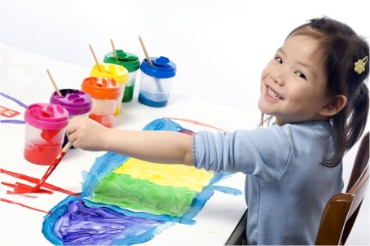

The Curriculum – The 4 Capacities
Successful Learners
Confident Individuals
Effective Contributors
Notes:
Every culture makes decisions on how to educate their children.
They decide which knowledge and skills they should learn; when, where and how they should learn it, and which values and traditions they would like their children to develop to take their place in its society. That’s generally what we mean by ‘The Curriculum’.
In Scotland, at the moment, we are following the Curriculum for Excellence.
So, when the Scottish Government was planning the Curriculum for Excellence, they began with the ‘Big Picture’ – When children in our culture have completed their education, even though each one will be different, what would we want them to be able to do and be like?
After much debate, our Government came up with the Four Capacities – four attributes that everything we do in school should help to develop in our children.
Successful Learners
Confident Individuals
Effective Contributors
Responsible Citizens
These, then, are the four capacities that everything else we do in school is built on.

Slide 44
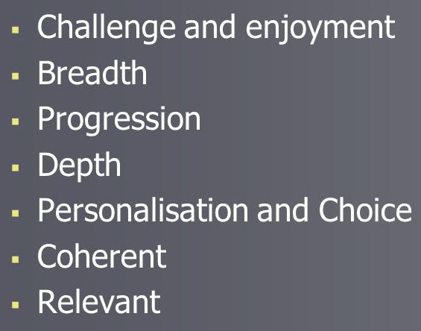
The Curriculum – The 7 Design Principles
Notes:
Having decided on the 4 capacities we would like to develop in all children and young people in Scotland, a curriculum had to be designed to make them a reality.
When designing the curriculum, there are 7 design principles we have to take into account. These are:
Challenge and enjoyment
Breadth
Progression
Depth
Personalisation and choice
Coherent
Relevant.

Slide 45
Curriculum Structure - CfE Levels
Early Level : The pre-school years and Primary 1
(3 – 6 years)
First Level : Primary 2, Primary 3 & Primary 4
(6-9 years)
Second Level : Primary 5, Primary 6 & Primary 7
(9-12 years)
Notes:
In the Curriculum for Excellence, the knowledge, skills and attitudes that children should be working on during the pre-school and Primary school years are split up into three different levels.
Each level has a number of experiences that the children will engage in, and a number of outcomes (that’s the things they should learn) by doing so.
For ease of organisation, these levels are described by year groups, but as children are individuals and all different it is important to remember that the levels are just that, an organisational feature.
Early Level
First Level
Second Level
These levels are not rigid - in Carmondean, we have children who are in Primary 1 working on experiences and outcomes of the First level.
Equally, we have children in Primary 2, 3, & 4 who still have aspects of Early Level to attain.
Children who enter Primary 1 will be building on the experiences and outcomes of the Early Level, which began in the Nursery or Pre-school setting.

Slide 46
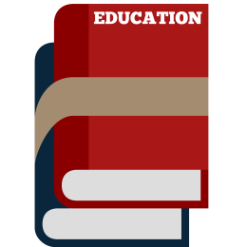


Curriculum Structure - CfE Levels
Third Level : Broad General Education
(12-15 years old)
Fourth Level : Personal Choice of Subjects
(14-15 years old)
Senior Phase: Studying for qualifications
(15-18 years old)
Notes:
When children go to secondary school, they continue to study the Broad General Education, but at different levels.
Third Level – continuing on from second level
Fourth Level – gives opportunity for young people to choose what they would like to learn about
Senior Phase – for those young people wishing to continue at school or college to gain qualifications.

Slide 47

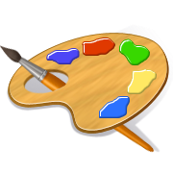
The Curriculum - Subjects
Literacy &
English
Sciences
Numeracy &
Mathematics
Technologies
Health &
Wellbeing
Social
Studies
Expressive
Arts
Religious & Moral
Education
Notes:
The preparation for becoming familiar with the Curriculum begins in the Nursery. Although children aren’t aware of it at the time, the things they are learning about are the very first building blocks of the bodies of knowledge known as subjects.
In Primary School, the curriculum consists of eight subject areas.
Literacy & English: Listening and Talking, Reading, Writing. This area also includes other languages, which will be French to begin with.
Numeracy and Mathematics: Number, Money and Measure, Shape, Position and Movement and Information Handling
Health and Wellbeing: All things to do with health, including PE and Sport
Expressive Arts: Music, Drama, Art and Dance
Sciences: Planet Earth, Forces, Electricity and Waves, Biological Systems, Materials and Topical Science – science as it is being played out in daily life.
Technologies: A huge area which includes engineering, food and textiles, ICT and computers, etc., etc., etc.
Social Studies: Basically History, Geography and Modern Studies, including Enterprise education.
Religious and Moral Education: Christianity, World Religions selected for study and Development of Beliefs and Values. At the moment, the two World Religions which have been selected for study are Islam and Judaism.
Of these 8 subject areas, three are considered to be core subjects. These are:
Literacy & English
Numeracy & Mathematics
Health & Wellbeing.

Slide 48
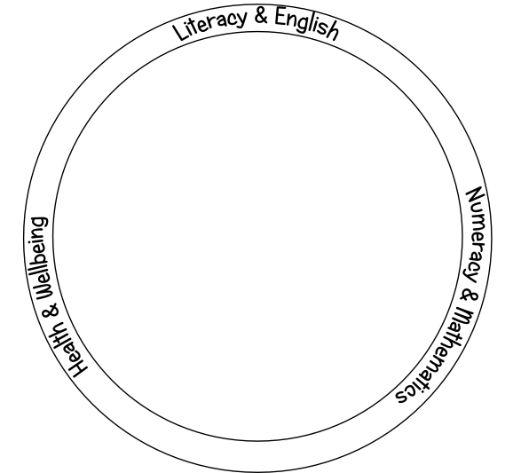
The Curriculum – Core Subjects
Notes:
These subjects are considered to be ‘The Responsibility of All’. That means that, whoever is working with the children (be it visiting specialists, class teacher, Pupil Support Worker, etc.), they should be planning to include aspects of these three subjects, as appropriate, no matter what they are teaching.
While learning in the Expressive Arts, listening and talking may be developed;
When learning in Social Studies, Numeracy may be developed, for example comparing population figures in different countries;
When learning in Technologies, Reading for information will play a part as well as using technology to assist writing;
When learning in Sciences, Health and Wellbeing may be developed by looking at the effects of exercise on the body;
When learning in modern languages, all three core subjects will play a part;
And when learning in R&ME, many Health and Wellbeing skills will be developed while looking at, e.g., food laws, etc.

Slide 49
The Curriculum – Interdisciplinary Learning
The Vikings
Notes:
Much of the learning and teaching is done through interdisciplinary learning and through ‘topics’.
Just like the curriculum levels are an organisational feature, subjects are the same.
If children are learning about the Vikings, for example, they will use experiences and outcomes from more than one subject to help them.
They may learn about the history of Vikings and the Geography of their native lands – that’s Social Studies.
They may learn about how Vikings decorated their jewellery and pottery and which styles of clothes they wore – that’s Expressive Arts.
They may use computers to find out about and present a piece of personal research – that’s Technologies.
They may learn about how Vikings believed their lives were ruled by the will of the Norse Gods – That’s Religious and Moral Education.
Different subjects, same topic.
As children progress through the school, individual subjects take on more importance as they prepare to make decisions about what they will study at Secondary School.
To Summarise:
The curriculum consists of 8 subject areas, of which three are core subjects – Literacy & English, Numeracy & Mathematics and Health and Well-being.
In the pre-school and Primary school years, the curriculum is split into three levels, Early Level (N1, 2 and P1), First Level (P2, 3 & 4) and Second Level (P 5, 6 & 7), although these are for organisational purposes only.
Much of the learning that takes place will not be based on subjects, but will be tackled as a series of Interdisciplinary studies.

Slide 50
The Curriculum – The 4 Capacities
Successful Learners
Confident Individuals
Effective Contributors
Notes:
And, to re-cap, the purpose of all of this is to produce
Successful Learners,
Confident individuals,
Effective Contributors
and
Responsible Citizens.

Slide 51
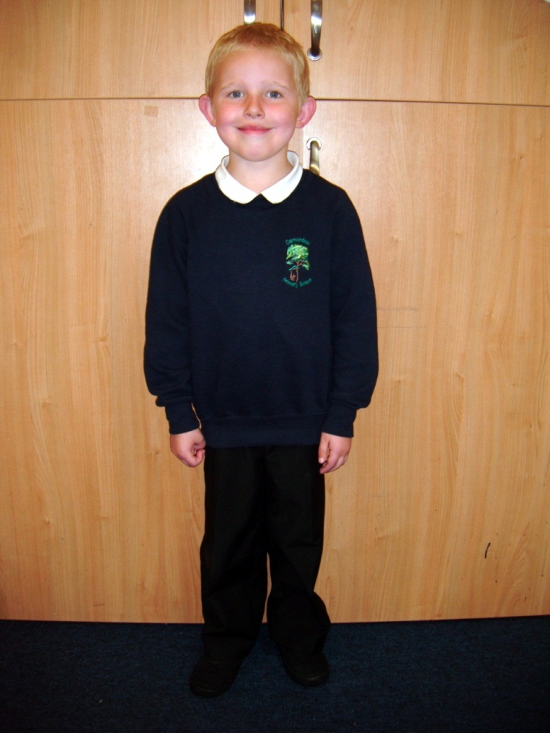
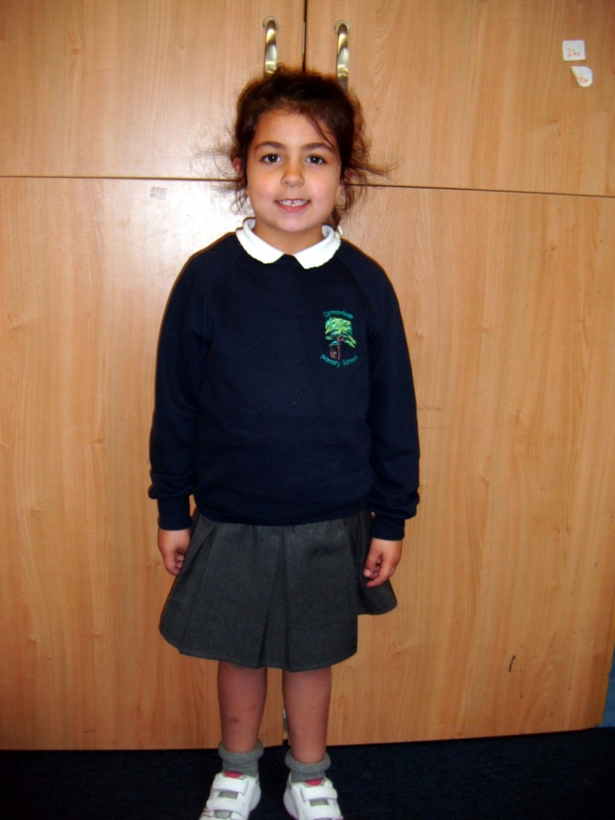
Other Features of our Education System
Most children in Scotland wear a school uniform
Notes:
Most children in Scotland wear a school uniform.

Slide 52

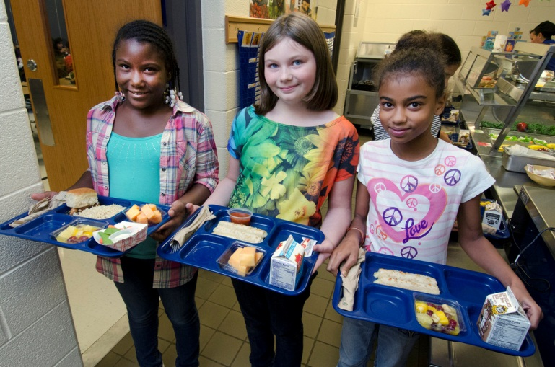
Other Features of our Education System
All children can have a free breakfast in school and Primary 1-3 children can have a free lunch
Notes:
All children can have a free breakfast in school and Primary 1-3 children can have a free lunch.

Slide 53
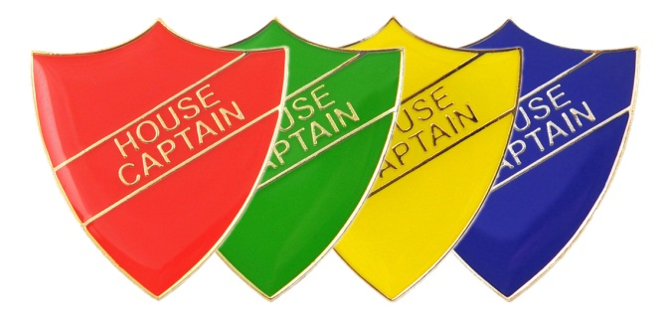


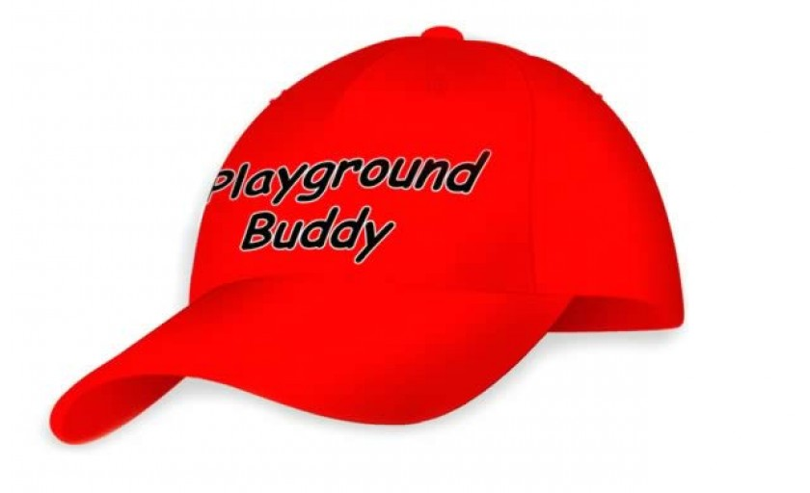
Other Features of our Education System
Children and young people are encouraged to play a part in the decision-making of schools.
Notes:
Children and young people are encouraged to play a part in the decision-making of schools.
In Carmondean we have:
House Captains,
A Pupil Council
An Eco Committee
Playground Mentors
Primary 7 Buddies.

Slide 54

Other Features of our Education System
Many schools have after-school clubs with a huge variety of activities
Notes:
Many schools have after-school clubs with a huge variety of activities.
At Carmondean, we have 21.

Slide 55

Other Features of our Education System
Many schools are part of the Rights Respecting Schools initiative based on U.N.C.R.C.
Notes:
Many schools are part of the Rights Respecting Schools initiative based on U.N.C.R.C.
Carmondean has reached Level 2 of this initiative.

Slide 56

The Aim of our Education System
Curriculum for Excellence aims to achieve a transformation in education in Scotland by providing a coherent, more flexible and enriched curriculum from 3-18
Notes:
Curriculum for Excellence aims to achieve a transformation in education in Scotland by providing a coherent, more flexible and enriched curriculum from 3-18.

Slide 57

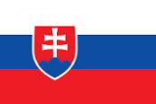

EDUCATIONAL SYSTEM IN SLOVAKIA

Slide 58

THE STRUCTURE OF EDUCATIONAL SYSTEM IN SLOVAKIA
Educational system in Slovakia has been changed in last few years.
School attendance in Slovakia is compulsory from the age of 6 to 16.
There are state schools, private schools and church schools.

Slide 59
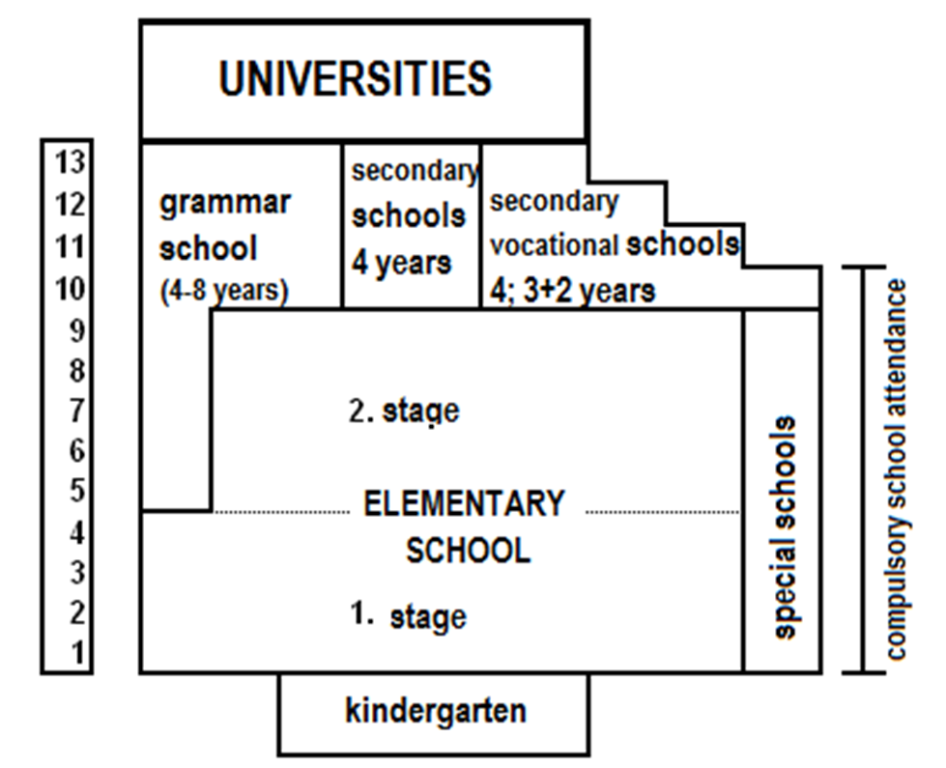
THE STRUCTURE OF EDUCATIONAL SYSTEM IN SLOVAKIA

Slide 60

THE STRUCTURE OF EDUCATIONAL SYSTEM IN SLOVAKIA
Stages of education:
pre-school education,
primary education (two stages),
secondary education,
post-secondary education,
higher education - university.

Slide 61
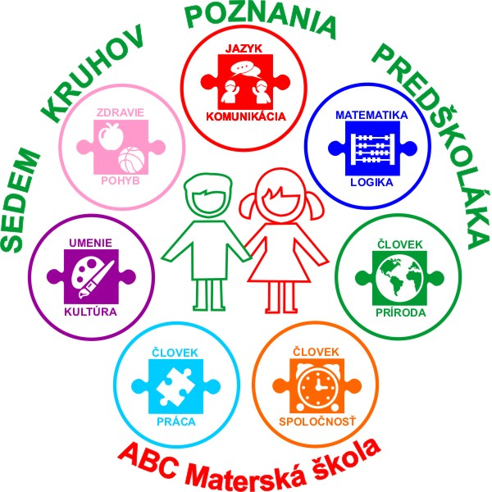

CURRICULUM
is voluntary,
prepares children for primary school in several elementary educational subjects: maths and information, art, society, work, nature, health and physical exercises.
Includes: nursery, kindergartens and special kindergartens for disabled children.

Slide 62

Primary education
gives children general education e. g. Languages, History, Geography, Maths, Physics, Chemistry, Biology, Arts, Religion or Ethics, Physical Exercises and games...

Slide 63
CURRICULUM
Secondary schools:
(pupils have to pass entrance exams to continue their studies at secondary schools)
Grammar school – prepares students for universtities in general subjects and languages
Secondary business, technical, medical or pedagogical schools – prepare students for universities or for job in theoretical teaching with practical training (1 months a year).
Vocational schools– prepare students for crafts and skills in practical training, they have own practical centres and cooperate with real employers.
Study ends with either with achiewing a skill certificate or with a school-leaving exam.

Slide 64

CURRICULUM
Universities:
study takes:
3 years Bc.+ 2 years Mgr. (a teacher, a psilosopher, a chemist, a theologian, a jurist...),
3 years Bc. + 2 years Ing. (a technical engineer);
6 years MUDr., MDDr., MVDr., (a doctor, a vet),
study finishes with graduation where graduates are given diplomas.
Study and work at university can continue to next degrees PeadDr., PhDr., RNDr., JUDr., PharmDr., ThDr., PhD. etc.

Slide 65
SPECIFIC FEATURES
The school year starts on September 1st and finishes on June 30th.
Students get school reports at the end of January and June and they are assessed by marks from 1 to 5 (1 is the best).
A lesson usually lasts 45 minutes and breaks are 10 or 15 minutes long. Lessons usualy start at 8 am and finish at 2 pm.
All schools have a lunchroom with warm meals.
Apart from lessons many schools offers various after-school activities like sports, drama, languages ...

Slide 66
SPECIFIC FEATURES
During the year there are few days off
(for example the All Saint’s Day, Easter days or the May days 1 and 8).
There are winter holidays, which last about two weeks and spring holidays (not for kindergartens), which last one week. The summer holidays are the longest and last two months for primary schools and four weeks for kindergartens.

Slide 67
There are several schools with special educational program, philosophy and curriculum for example Montessori, Waldorf, Dalton plan, Integrated thematic education, Teaching system with closed loop.
SPECIFIC FEATURES

